Slide 1

Reaching and Engaging with Hispanic Communities: A Researched-informed Communication Guide For Nonprofits, Policymakers, And Funders
Webinar October 18, 2016

Slide 2

Webinar Objectives
To provide Webinar participants with:
Research-based information about how the Latino communities obtain information
Research-based recommendations to effectively communicate with and engage Latino communities
Share perspectives from diverse stakeholders regarding the need for and use of strategic communications among service providers

Slide 3

Join the conversation on twitter
#ReachingLatinos
@ChildTrends
@CrimsonbridgeDC

Slide 4
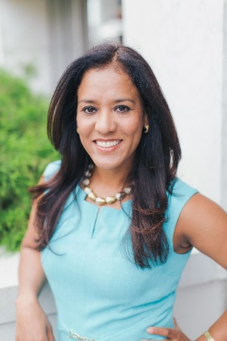
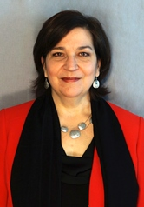


Who Are the Panelists?
Alicia Torres, Ph.D.
Senior Director of Communications
Child Trends
Selma Caal, Ph.D.
Research Scientist
Child Trends

Slide 5
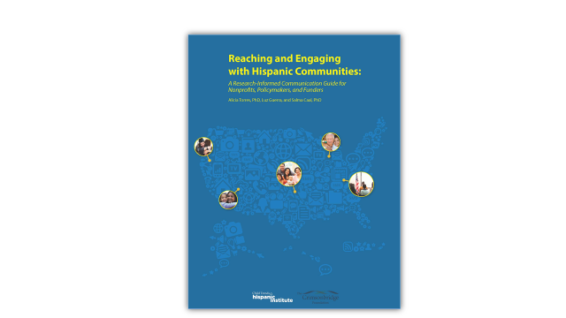

Introductory remarks

Slide 6

Purpose
Intended for:
Providers—serve low-income Latino families
Funders—partner with and support providers
Policymakers—work impacts programs
Notes:
Thank you Danielle– We will now present the overview of the
Guide--Reaching and Engaging with Hispanic Communities: A Research-Informed Communication Guide
The communication guide has been prepared for:
service providers and educators who work with Latino or Hispnic children and their families, in particular, working with low-income Latino families
for the funders who partner with them
for policymakers whose work impacts programs that serve Latinos

Slide 7

Why communication?
Effective communication Strategies
Integral to an organization's success
Advance its mission, goals and capacity to serve
Key to developing strong and lasting relationships
Streamline operations/maximize the impact of resources
A well-crafted message
Attracts new people to an agency
Clearly communicate: services /eligibility requirements
Facilitates participants’ self-selection
Funders want to be confident
Contributions used effectively
Increasingly supporting core communication
Notes:
SO WHY DID WE CHOOSE TO FOCUS ON COMMUMNICATIONS
Integral to an organization's success
Advance its mission, goals and capacity to serve
Key to developing strong and lasting relationships
Streamline operations and maximize the impact of funders’ dollars/resources
A well-crafted message
Attracts new people to an agency
Clearly advertises program-- purpose, schedule, costs, and eligibility
Makes it easier for potential participants to self-select for programs - meet their needs—
YOU WILL HEAR LATER ON ABOUT HOW THE RESEARCH HAS FOUND THAT HISPANICS DO NOT ACCESS SERVICES AT THE SAME RATES AS THEIR PEERS EVEN WHENJ THEY ARE ELIGIBLE— DUE AMONG OTHER REASONS TO THE MISCONSPETION THAT THEY ARE NOT ELIGIBALE
Funders want to be confident their financial contributions are used effectively
Increasingly support core communication to improve impact of limited resources
.

Slide 8
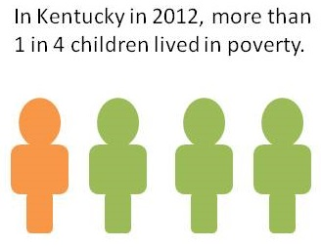

Why Focus on Latino Communities?
1 in 4 of all U.S. children
are Hispanic
  Fastest growing
  Largest racial/ethnic group
  By 2050: 1/3 of all children
  Source: U.S. Census Bureau, 2013
2 in 3 Latino children live at or near poverty
  Majority form part of target population
    Policies
    Service programs
  Source: U.S. Census Bureau, 2013
  Source: Child Trends’ Analysis of March Current Population Survey Data (2013)
Notes:
1/4th of all children today– are Latinos
Are the fastest growing and largest racial ethnic group in the country
In a few decades will represent one third– roughly the same percentage as white children
So how todays children develop and grow– will have important implications for the future of the country.
But unfortunately many Latino children are growing up facing challenges
We know that 2/3rds live at or near poverty
Which means that MAJORITY OF ALL LATINO CHILDREN IN THE COUNTRY TODAY FORM PART OF THE POPULATION SERVED BY POLICIES AND PRGRAMS AIMED AT IMPOVING OUTCOMCES FOR CHILDREN– THEIR HEALTHY DEVELOPMENT AND FUTURE WELLBEING
ill Four demographic facts.
Future in many ways depends on their healthy development and well being– fro a number of reasons including that Latino children being born today will be the majority of tomorrow’s work force
1.Today, roughly 1 in 4 of all children in the U.S. are Hispanic.
Hispanics are the fastest growing and largest racial/ethnic group among children.
By 2050, Hispanic children are projected to be more than 1 in 3 of all children roughly the same percentage as white children.
As such, how Latino children fare in their growth will have profound implications for our country.
2. Economic security is precarious for many Hispanic children
Roughly, 1/3 of Latino children live in poverty
And, 2/3 live in low- income families (defined as those with incomes less than twice the poverty line)
In other words, the majority of Hispanic children are part of the target population that of programs and policies
3. The vast majority of Hispanic children are U.S. born
In fact, recent increases in the Latino population are being driven not by immigration but by births.
4. Although the vast majority of Latino children are U.S. born, the immigrant experience is a reality for many.
Roughly half (53%) have at least one parent who was born outside of the U.S.
And, roughly ¾ (74%) speak a language other than English at home
As we think about our programs and policies and how best to support Hispanic children and families, it is important to consider these family experiences including their exposure to languages other than English and poverty as well the diversity of the Latino population
--And will be 1/3 of our future work force (2060)

Slide 9
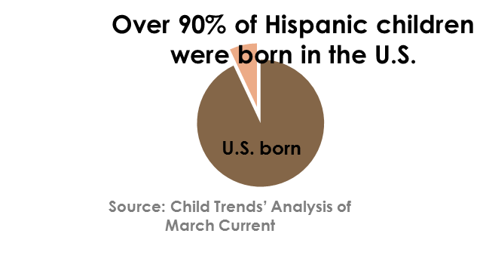
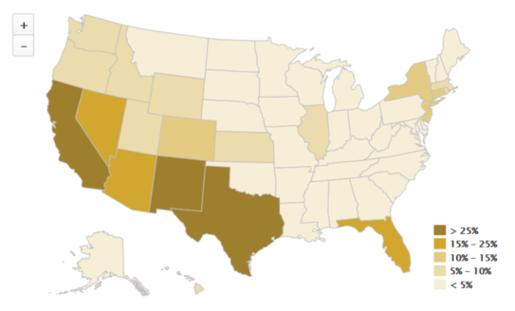
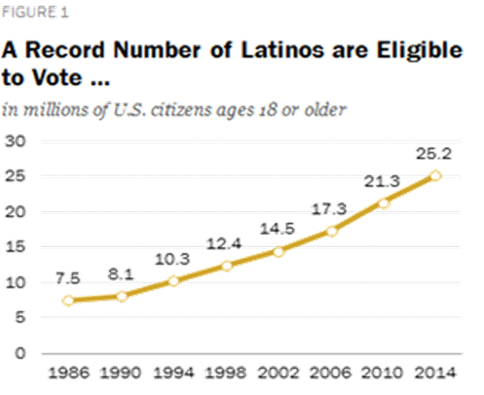

Latinos are becoming an increasingly large share of the country
Notes:
As Latinos are becoming an increasingly larger share of the country
There are a number of stakeholders who are paying closer attention to Latinos– for many reasons
FOR EXAMPLE
Today more than 90% of all Latinos are born in the U.S.
As U.S. Citizenship has grown– so have the number of those eligible to vote
There was a 3 fold increase in less than 30 years
Translates into important share of the electorate in number of states– those in the darker colors on this map– indicates states where Latinos represent an important sector of the total electorate ----and potential swing votes.
Something that during election season is front and center
Latinos across the country represent important sectors of the electorate with:
Large percentages in states as TX, FL, CA and NY
But also potential swing votes in many other states where they represent 5, 10, 15% of the vote
Of Reliable and Actionable research
THERE IS REATER RECOGNITION THAT THERIE IS A LOT AT STAKE IN THE ENSURING THE HEALTHY DEVELOPMENT AND WELL-BING OF LATINO CHILDREN

Slide 10

Why Service Providers?
As Latino population has grown, so have service providers
To make a difference -- must reach/engage effectively with Latino families
Service providers exist for the communities they serve
Regardless of business model: public, private, fee for service or membership
Not all providers have experience with Latino communities
  Some already have a strong track record
  Others are learning to respond to the needs
  of their new or expanding base
  Even w/deep roots in established communities- stay abreast of changing needs
Notes:
Those are a few of the reasons we focused on Latinos– why service providers
And we’ve seen that as the Latino population has grown, so have organization that provide services
To make a difference -- must be able to reach and engage effectively with Latino families
Service providers, like schools, exist for the communities they serve
Financed with public and private monies: government , foundation, fees for service and/or membership fees
Not all providers have experience with Latino communities.
Some already have a strong track record with Latino communities
Others are learning to respond to the needs of their new or expanding client base
AS THERE ARE A NUMBER OF NEW COMMUNITIES DEVELOPING IN NON-TRADITIONAL PLACES THOUGHOUT THE COUNTRY
Even those with deep roots in a long-established Latino community can benefit from reassessing how they are reaching this target audience, and determining changing needs– AS EVEN THESE COMMUNITIES ARE UNDERGOING MANY CHANGES.

Slide 11

Research and Practice Informed
Extensive review of literature and focus groups
On the ground, in the field experiences
Heard from a range of demographics
Notes:
So in taking all of this into consideration– particularly the need to better ensure that Latino families are aware of the services available to assist them in the healthy development and well being if their children, we decided to develop this guide.
The guide is informed by research
We conducted an extensive review of the literature --looked at :
WHAT DO WE KNOW ABOUT WHERE LATINOS GET THEIR INFROMATION,
WHAT ARE THEIR TRUSTED SOURCES,
HOW DO THEY PREFER TO BE REFERRED TO ,
AND HOW DOES THIS CHANGE AMONG DIVERSE COMMUNITITES ACROSS THE COUNTRY
We then took this information to the field and heard from parents in five different focus groups-different countries of origin: MX . CA, SA and Caribbean.
We also conducted 14 interviews with providers across the country who worked in organizations providing social, educational, or health services.
So we heard from a range of demographics AND GEOGRAPHIC AREAS

Slide 12
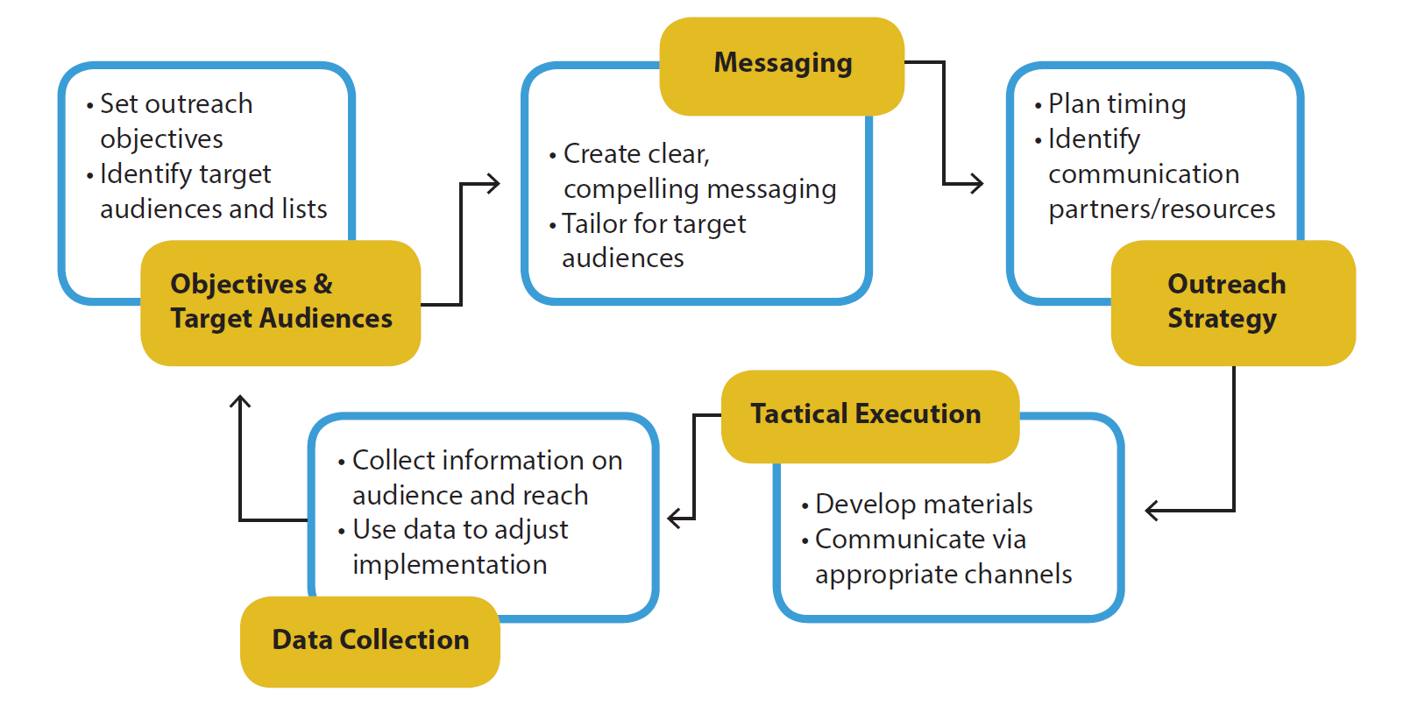

Communication Guide Based on a Strategic Communication Framework
Notes:
We took our research finings and we used this strategic communication framework to develop our guide.
Begins by knowing your audience– KNOWING YOUR AUDEINCES
Is THE BASIS for you to develop achievable objectives that meet their needs
Knowing your audience PROVIDES A ROAD MAP FOR developING messages that speak to the communities you serve in a way that makes sense and resonates among them– in their preferred language.
And to implement outreach strategy based on their preferences and trusted sources of information
Then when executing your communication outreach–
Its important to develop metrics that will help you gage the effectiveness of your efforts and indicate ways you can improve your next effort.
WITH THAT OVERVIEW- I WILL NOW TURN OVER TO MY COLLEGUE WHO WILL FLUSH OUT THE KEY RECOMMENDATIONS WITHIN THIS FRAMEWORK
According to this framework, you can effectively engage your audience by first articulating your outreach objectives and identifying your target audience.
It is then, when you develop a clear and compelling message that is carefully crafted for your target audience.
You then identify your outreach strategy, identifying the timing and partners/ resources
It is then when you develop your outreach/communication materials and you communicate these via the appropriate channels
It is always advisable to conduct data collection of your audience and reach so you can use these data to adjust your outreach strategy.

Slide 13
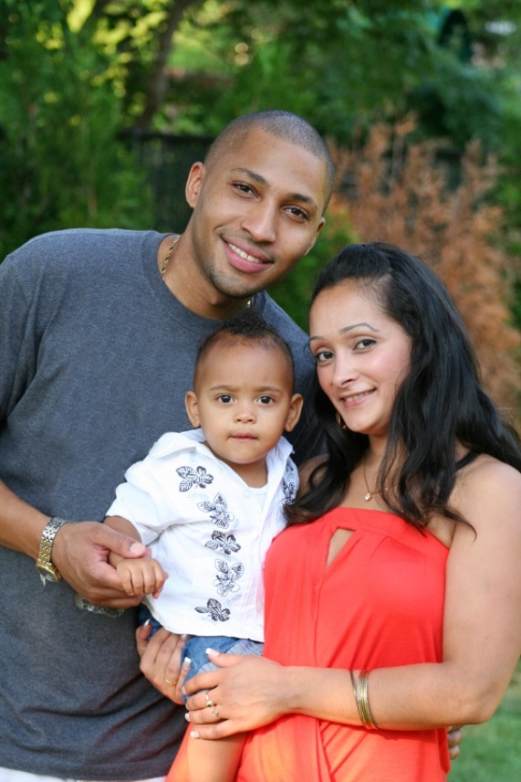
Recommendation:
Know your audience
Differences between communities influence how Latinos receive and interpret messages and how they use/respond to outreach efforts
It is important to:
Conduct an audience assessment
Know the heritage, culture and understand diversity
Pay close attention to language preferences - the future is bilingual
Understand their needs
Identify how they gather/access information and their trusted sources
Notes:
So now, let’s talk about our recommendations:
Drawing from the communications framework, first we recommend to know your audience, differences between communities are likely to influence how Latinos receive and interpret messages, AND how they respond to your outreach efforts.
To get to know your audience, we recommend conducting an audience assessment.
you’ll want to understand the diversity of this community, their heritage and culture.
As you may know some Latinos have been here for generations, others have immigrated from different countries, and have settle in different geographic regions in the US.
It is also important to pay close attention to language preferences. Some Latinos may be bilingual, while others may be English dominant, and others may be Spanish dominant.
Also, like in English-speaking countries, Latinos from different countries may use different words that have the same meaning. For example, in Mexico the word Chamaco is used for the word child while this is not used in other countries.
Understand the needs of your Latino audience relating to services your organizations provides, AND identify how they gather/access information and what trusted sources they use to access information.

Slide 14
Diversity Among U.S. Latinos
Notes:
This pie gives us a sense of the diversity among Latinos living in the United States. As you see, the background of Latinos comes from different Latin American countries with the majority coming from Mexico.

Slide 15
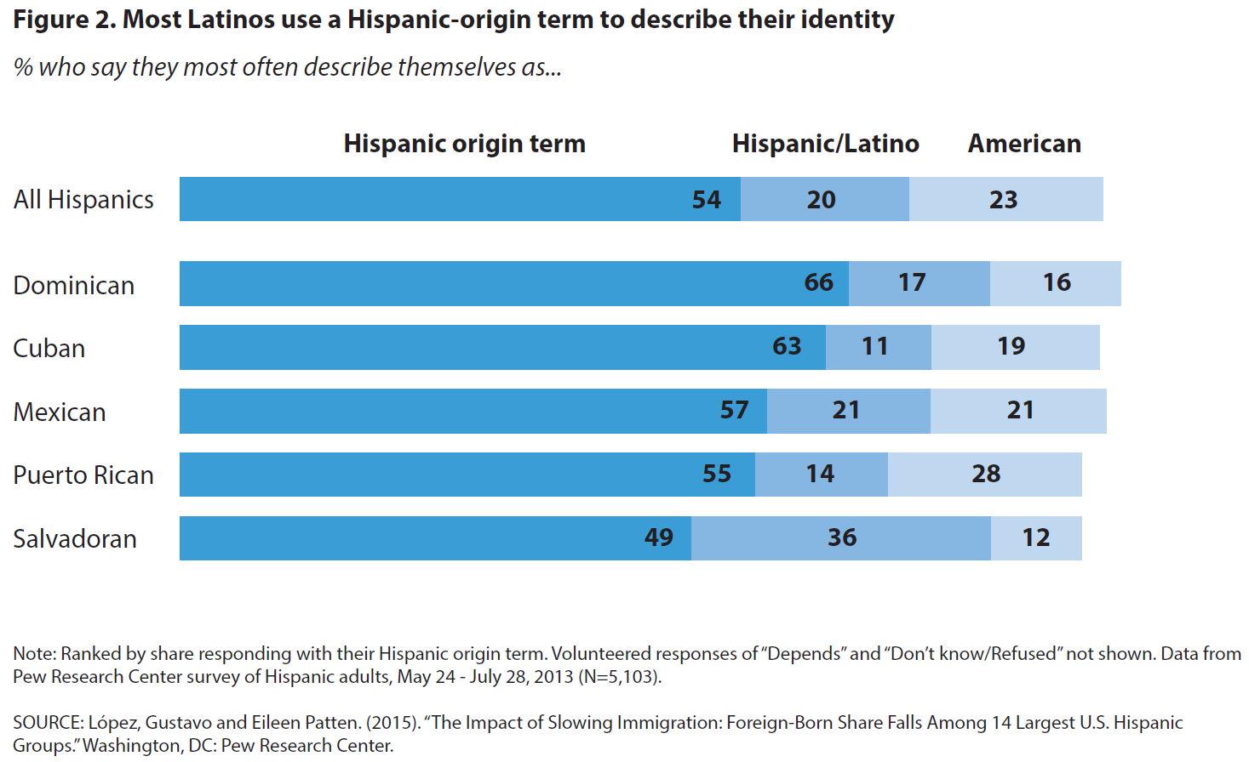
Recommendation: take note of preferences for outreach efforts
Many Latinos have strong preferences about how they self-identify
Notes:
Based on our research, we recommend that you take note of the preferences Latinos have so you can build your outreach efforts around their preferences. We know that messages that take into consideration the audience’s preferences are more effective.
For example, let Latinos self identify; this may engage them more in your outreach efforts.
While the U.S. Census Bureau and most news outlets have opted to use "Latino" and "Hispanic" interchangeably, as you see here, most Latinos identify themselves by their family’s country of origin. For example, 66% of Dominicans self-identify as “Dominican”. Whereas, 17% identify as Hispanic or Latino, and 16% identify as American.
However, this was not necessarily the case in our focus groups; some parents defined themselves as Hispanic while others as Latinos AND a few preferred to self-identify with their country of origin; all of these parents had their own reasons for their self-identification.

Slide 16

Recommendation: take note of preferences for outreach efforts
Personal contact remains the most direct and effective way to communicate with Latino families
  Door-to-door visits
  Distributing flyers to people on streets with heavy pedestrian use
  Meeting parents and students at schools and school bus stops
  Attending community events
Notes:
We also recommend that you take note of the community’s preferences for outreach efforts.
As many of you may know, through our research we found that personal contact remains the most direct and effective way for service providers and educators to communicate with Latino families.
Personal contact
such as door-to-door visits, distributing flyers to people on streets
Meeting parents and students where they are, for example: at schools and school bus stops, and at community events
While these can be labor-intensive, our research and literature review suggest that these outreach efforts are effective to reach Latinos, especially hard to reach audiences.

Slide 17

Recommendation:
Build partnerships & Leverage “influencers”
Engage & partner with well-respected, trusted community organizations
  Civic community organizations
  Organizations serving children often trusted and a conduit to Hispanic families
Work with “influencers” who can open doors to the community
Persons families may turn to for advice and counsel
This person has the credibility to:
  give advice
  affect opinion
  call for action
Notes:
To strengthen buy-in from Latino families, we recommend that you build partnerships and leverage “influencers.”
Partnering with well-respected, trusted community organizations, such as those serving children, is a good idea. We heard from parents that they are receptive to information when it comes from organizations they trust.
Working with “influencers” can be another effective strategy to reach your Latino audience
An influencer is: a person that families may turn to for advice and counsel typically because this person has more knowledge or information about the issue in question, giving him/her the credibility to effectively give advice to the family or advice for action.
Examples of influencers would be a priest or a teacher

Slide 18

texting and phone CALLS complement other communication
Texting and phone calls complement and reinforce other communication outreach efforts.
Focus group parents preferred face-to-face interactions, but agreed that phone calls help them engage more directly with the provider
This was particularly the case for phone calls with participants with low-to-no literacy skills
Notes:
You may also want to use texting and phone calls as a way to complement and reinforce other communication efforts.
We heard from focus group participants that they prefer face-to-face interactions, but they said that phone calls could also help them engage directly with the provider. This was particularly the case for participants with low-to-no literacy skills. They said they may not be able to read a flyer or a website, but are able to engage in conversations with the provider, especially if a bilingual person contacts them.

Slide 19
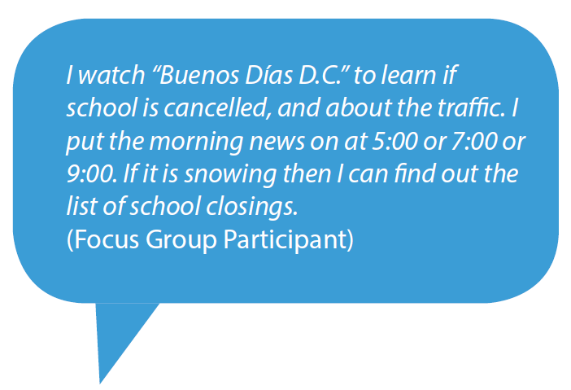
Reach Latinos through the media channels they rely on most
Most Latinos rely on traditional media like television and radio for information
Local TV News - news source most used
  90% of African Americans
  80% of whites
  79% of Hispanics
50% of Latinos also rely on Latino-specific news for information about their community
  Local community newspapers
  On the radio, Spanish-language stations still dominate
Notes:
We suggest reaching Latinos through the Media sources they rely on most.
We know from extensive research over the years that most people still use traditional media, and in fact local TV news is the primary source for information across all the country and ethnic/racial groups.
90 percent of African Americans rely on local TV news
80 percent of whites rely on local TV news
79 percent of Hispanics rely on local TV news as well
In addition, we also know that Latinos rely on Spanish specific news for information in their community.
And on the radio, Spanish language radio stations still dominate.
As you see in this quote, we heard this from our focus group parents as well. This parent notes that she watches local TV news to hear the morning news, to learn about school cancellations, and traffic.

Slide 20


Take advantage of social media
Take advantage of social media, especially when reaching out to younger Latinos
The internet and social networks such as Facebook, YouTube, and Instagram
It can be a cost-effective way to:
  Communicate information,
  Develop rapport
  Build community with the right population
Providers did not find social media very effective in engaging many of the Latino communities with the exception of:
  Younger audiences
  Peer-to-peer communication
  Funder communication
Notes:
Take Advantage Of Social Media Platforms, especially when reaching out to younger Latinos.
Like others in the country, Latinos are increasingly using social media networks, such as facebook, to stay in touch with family and friends.
Organizations may want to consider how a social media can fit into their outreach and communication strategy, especially if these organizations serve young adults.
It can be a cost-effective way to communicate program information, AND it can help develop rapport and build community with the right populations.
Providers we interviewed did not find social media very effective in engaging many of the Latino communities. Instead, they found social media to be most useful in peer to peer communication, communication with funders, and if they served youth, with young audiences.

Slide 21
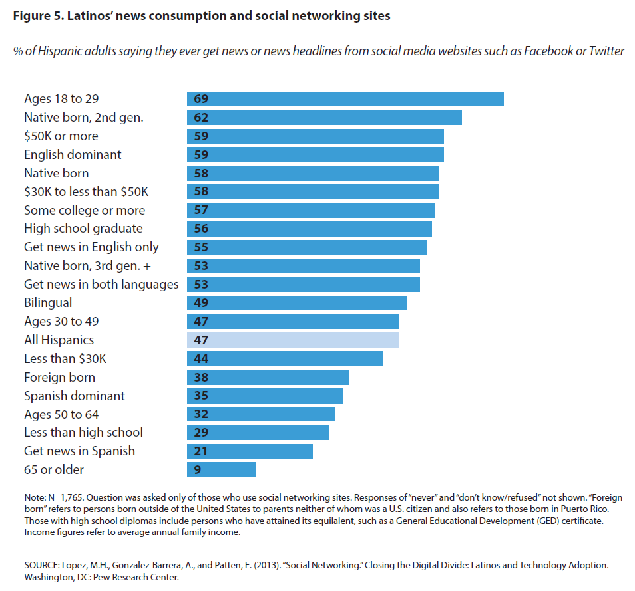
Hispanic Adults And Social Media
Notes:
In line with what providers said about social media use to reach youth, we see here in the top bar that young Latinos make up the greatest share of Hispanics who gets their news and information from social media
7 out of every 10 Latinos ages 18 to 29 say they get news or news headlines from social networking sites.
By contrast, only 1 out of every 10 Latino adults ages 65 and older do the same
This graph also suggests that, compared to their counterparts, low income Latinos, Latinos with less than a high school education, foreign born and Spanish dominant Latinos, are less likely to access social media.
So the take away of this slide is that a social media campaign can be MOST useful, only for a subset of the Latino population: young adults, native born Latinos and English dominant…

Slide 22
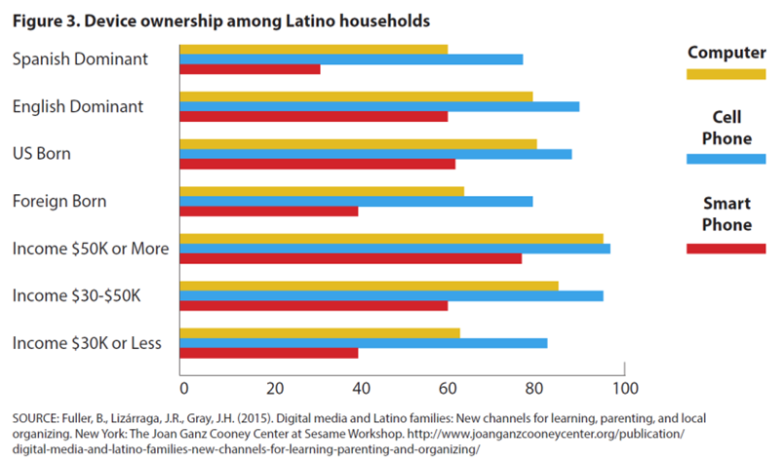
Technology Latinos have
Notes:
This graph illustrates the technology that Latinos have.
As you see here, a SMALLER percentage of Latinos from low income households, who are Spanish dominant, and are foreign born own a computer, cell phone, and/or a smart phone
Taken together the information from this slide and the previous one, we recommend that you do your homework before launching a social media campaign aimed at Latinos, keeping in mind the age, income, place of birth, and language preference of your Latino audience

Slide 23

optimize your website for mobile devices
Make sure your website is mobile-optimized, as some families are “smartphone dependent”
Mobile-optimized websites will give Latinos greater access to organization’s services
Consider using video on your websites as a way to inform users about your services and how they can reach you directly
Notes:
We also learned from focus group participants and the literature review that many low-income Latino families rely on their smartphone for Internet access, either because they don’t have access to a computer or they lack the technical skills to do so. As such, organizations may want to optimize their website for mobile devises.
Consider using video on your websites as a way to inform users about your services and how they can reach you directly
Parents using the internet in our focus groups, stated that videos of other parents providing testimonials about the services would be effective. These videos would not only provide testimonials, but they would be a way to inform users about the services and how they can reach them.

Slide 24

Keep in Mind…
Recent reports also suggest that many low-income families with smartphones or desktop computers still do not have reliable Internet access due to:
  having reached data plan limits
  interruptions in services
  internet service plans that are too often unaffordable.
  slow or aging devices
  devices that are shared by multiple family members
Notes:
It is important to Keep in mind
That not all households have access to the Internet; lower income families still lack a home computer or a smartphone as I discussed before, and even in homes with computers or smartphones, there are still barriers to going online.
Families may have reached their data plan limits;
They may experience interruption in services;
They may have internet service plans that are not affordable;
Families have slow and aging devices; and or
They may need to share these devices with multiple family members

Slide 25

track your results &
Learn from your outreach strategies
Track your results, adjust your strategies, and improve your communication and engagement
Keeping track of your communication efforts allows you to adjust your strategy
  Think critically about which components of your strategy were the most effective and which were least effective, and why
  To gain perspective about the communication process overall
  To refine and improve your communication strategies going forward
Notes:
To optimize your outreach strategies, it is important to track your results to learn from your outreach strategies.
Keeping track of your communication efforts will allow you to adjust your strategy
Once you have your tracking information, think critically about which components of your strategy were most effective and which were least effective, and why.
This will help you gain perspective about the communication process overall, AND how to refine and improve your communication strategies going forward
Now, I will turn it over to Alicia for some summarizing remarks and open it up to our panel.

Slide 26

Summary
An effective communication strategy
  Reaches the Latino populations most in need of services
  Engages with Latino families through preferred channels and relevant messages
  Establishes productive dialogues with communities served to understand their changing needs
  Provides a roadmap for you to tailor your services
  Maximizes impact of available financial resources
  Improves the lives and prospects for success of the largest and fastest growing racial/ethnic group of children!
Notes:
To sum up: An effective communication strategy will:
Help you determine how best reach Latino populations most in need of services
Guide you to effectively reach and engage with Latino families
Provide knowledge on how to establish consistent, productive, and ongoing dialogues between providers and the communities they serve; AND
How to maximize impact with available financial resources.
UTIMATLEY CONTRIBUTES TO HELPING TO Improves the lives and prospects for success of the largest and fastest growing racial/ethnic group of children!
AND LISTENING TO STARTS WITH UNDERSTANDING YOUR AUDIANCES

Slide 27

Respondent sandra gutierrez
Executive Director, Crimsonbridge Foundation

Slide 28
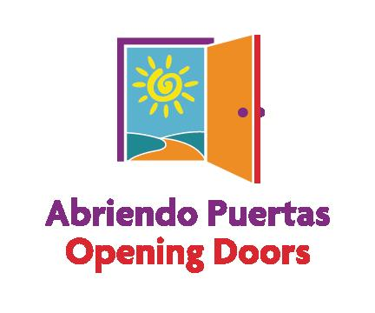
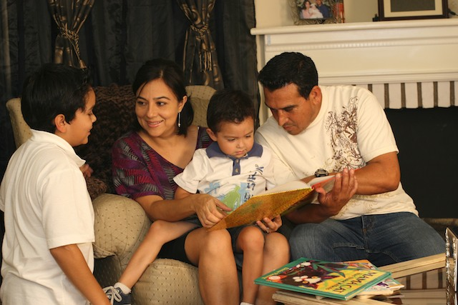
Desarrollando un Futuro Mejor a través del Liderazgo de los Padres
Building a Better Future Through Parent Leadership
^{Abriendo Puertas/Opening Doors}
The nation’s first evidence-based, comprehensive training program
created by and for Latino parents
with children ages 0-5
Notes:
Thank you, Alicia. As the national director of AP, I want to thank Child Trends Hispanic Institute and the Crimsonbridge Foundation for producing this Guide.
I want to share how we have used some of the recommendations that you highlight in Abriendo Puertas
First I will talk to a bit about our program.

Slide 29
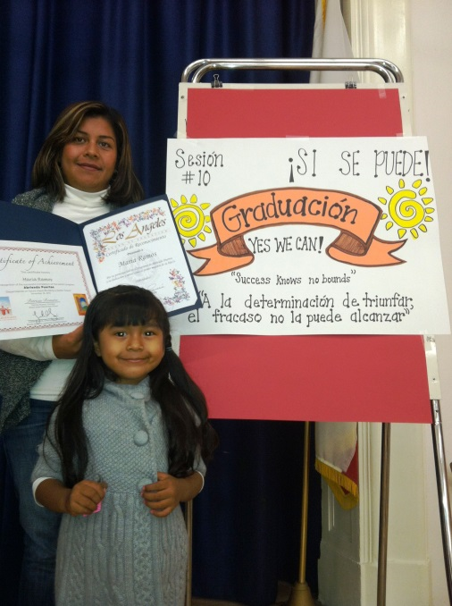
What is Abriendo Puertas/Opening Doors?
One of the largest culturally-relevant parent training programs in U.S.
  Developed by and for Latino parents of 0-5 year olds
  Implemented in English and Spanish in 324 cities and Puerto Rico
Grounded in education research
  Promotes best practices
  Popular Education
  Train-the-trainer model
Builds parents’ capacity and confidence as leaders of their family
Two generation approach that promotes parenting practices that foster:
  Children’s learning and development
  Parent leadership and advocacy
  Families’ connections to resources such as EITC and ACA

Slide 30
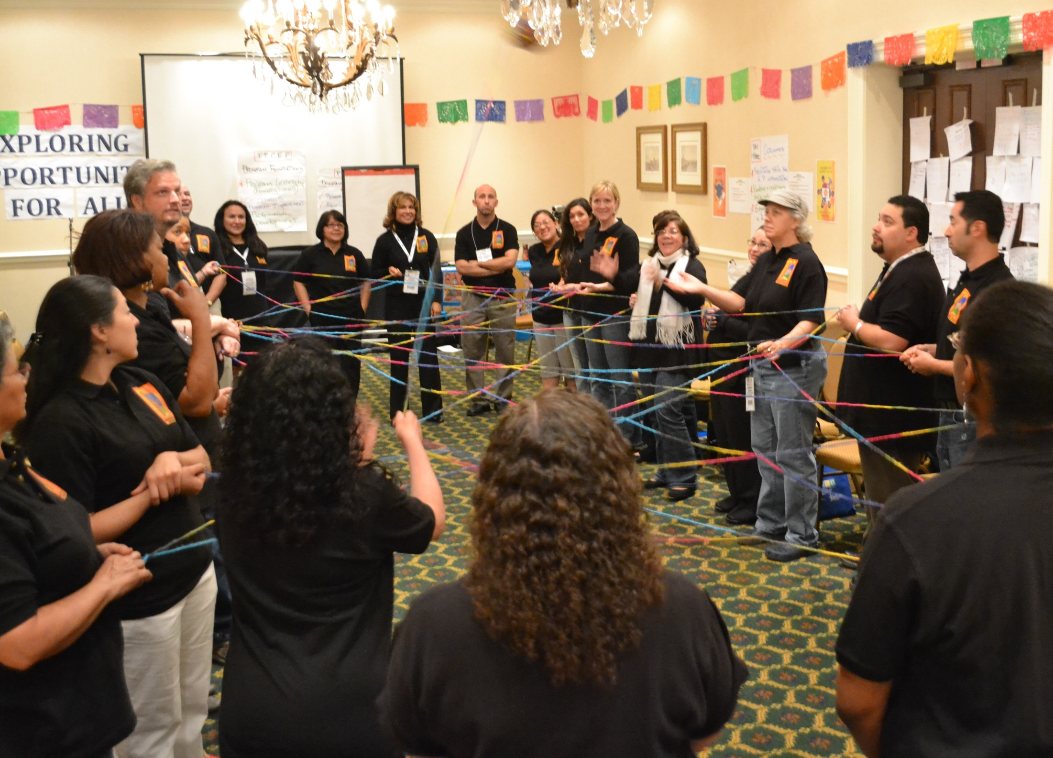
Notes:
Much of the success we’ve had with AP was accomplished by listening to the community and learning what they want and need. Based on this, we developed our program and outreach strategies.
AP works with mainly low-income and immigrant families– so I’m glad to see that the Guide takes into consideration the kinds of communication strategies that would work with specific communities with these characteristics:
Knowing your audience
Face to face and direct communications
Not to assume that Latinos will come to a website or feel comfortable applying on line– in fact it is important we have found to do things like have a video on a website with a talking head who lets people know how to reach the service provider by telephone.
Knowing the communities preferences related to language-- how people prefer to self-identify and level of literacy when developing messages.
Not just because the technology is there, will people necessarily use it.
Through using these kinds of strategies based on your audience we have found that you will reach your target population, serve the community your program intends to, and, at the same time fulfill the expectation of funders.

Slide 31

Respondent ANN RIVERA
Social Science Research Analyst,
Office of Planning, Research, and Evaluation,
Administration for Children and Families,
U.S. Department of Health and Human Services
Notes:
Tone: To validate ChildTrends findings on characteristics and experiences of low-income Hispanic Children&Families
· Overview- AVANCE reviews a lot of research reports and we must say that ChildTrends did an outstanding job on complimenting what our program has witnessed through the years
· Anecdotes on how AVANCE sees more cohabitating parents vs. single parents
· Parent Child Education Program (PCEP) Facts
Income
Ø Every program year, there are an average of 76% of participants that fall beneath the recommended income set by the Department of Health and Human Services, and are in poverty.
Residency
Ø On average, 85% of participants are foreign born.
Ø The average number of years in the United States after emigration is 10 years.
Family and Household
Ø 77% of participants have 2-parent households via cohabitation or marriage
o There has been an estimated 1.2% increase in the number of parent participating that live in 2-parent households.
Ø The average household size is approximately 5 members however, there are incidences of parents enrolling and having as many as 18 members of a family in a single household.
Ø Families with larger households in the program are multigenerational and composed of extended family.
o Most participants either rent a home or an apartment while larger families above 5 members in a household normally live with others.
Parenting
Ø Parenting style has become less Authoritarian (i.e. children seen not heard, parent is the ultimate decision maker, harsh punishment) to more Authoritative (i.e. children allowed to make decisions within reason, parents are authority in house and set boundaries).
Ø Men have begun to have an increasingly important role in parenting in the Hispanic community: there are men in the program that are single fathers.
Ø There has been in increase in cases of domestic abuse, drug use, and incarceration of men in our Chapters. (the case on importance of Fatherhood programs)
Ø The AVANCE Services to Fathers Program for the San Antonio Chapter has increased services and seen success with graduating 100% in Services to Fathers EHS and 88% for Services to Fathers Component of PCEP.
· So what?

Slide 32
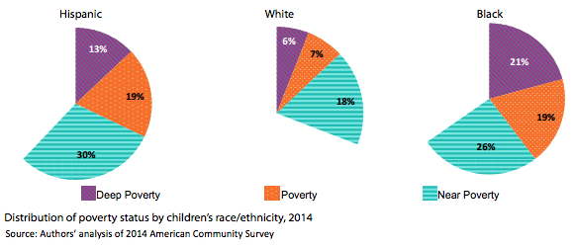
Two-thirds of Hispanic children in US
live in or near poverty
SOURCE: Wildsmith, E.; Alvira-Hammond, M.; and Guzman, L. (2016). A National Portrait of Hispanic Children in Need. Bethesda, MD: Child Trends.

Slide 33
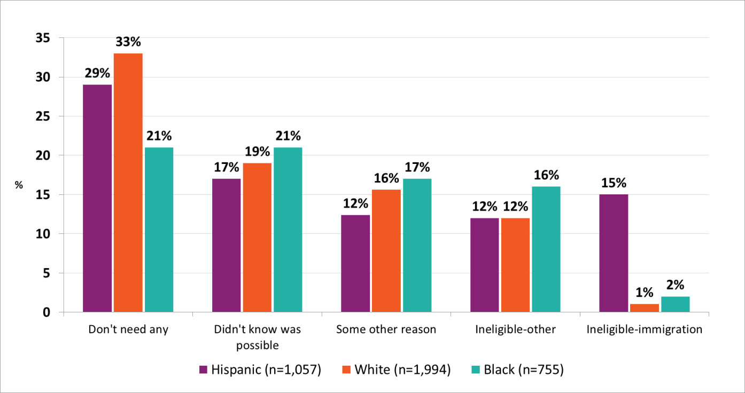
Most Prevalent Reasons Low-income Parents Report for Not Applying for Public Assistance
Analysis of 2008 Survey of Income and Program Participation. Subsample of parents in households within three lowest income quintiles.
SOURCE: Alvira-Hammond, M.; and Gennetian, L. (2015). How Hispanic Parents Perceive Their Need and Eligibility for Public Assistance. Bethesda, MD: Child Trends.

Slide 34
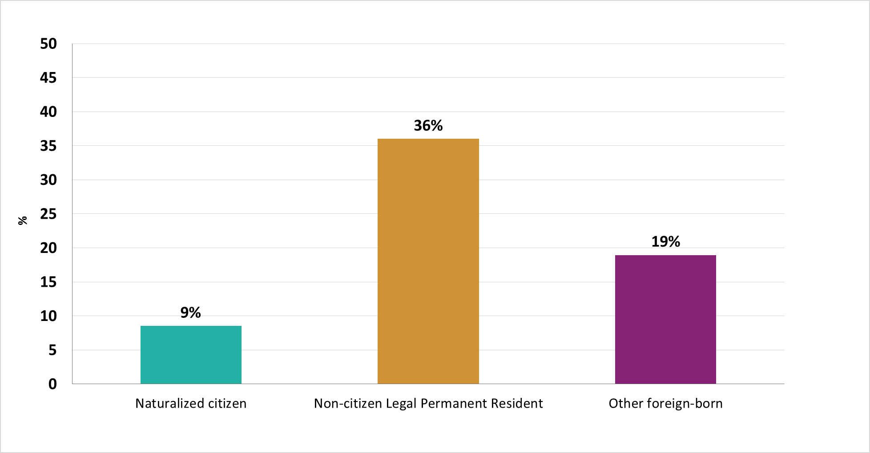
Percent of Foreign-born Hispanic Parents Reporting Ineligibility Due to Immigration Status, by Legal Status
Analysis of 2008 Survey of Income and Program Participation. Subsample of parents in households within three lowest income quintiles.
SOURCE: Alvira-Hammond, M.; and Gennetian, L. (2015). How Hispanic Parents Perceive Their Need and Eligibility for Public Assistance. Bethesda, MD: Child Trends.

Slide 35
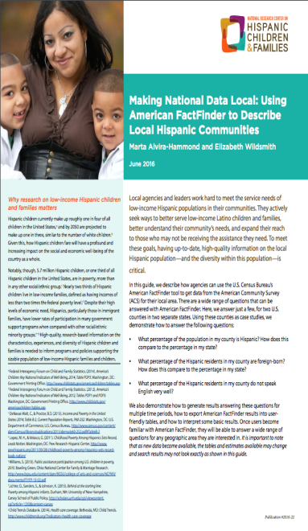
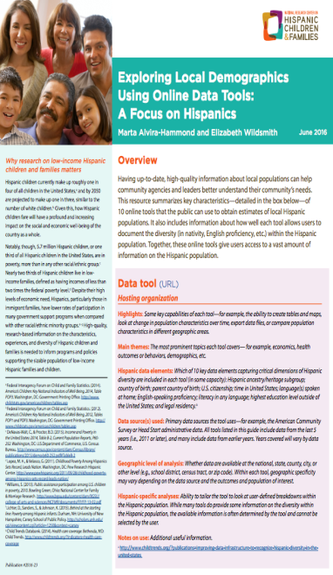
Tools to Strengthen Organizational Capacity of Local Agencies:
Making National Data Local: Using American FactFinder to Describe Local Hispanic Communities
Online Data Tools for Exploring Local Demographics: A Focus on Hispanics
Program Resource Guide: Supporting the Development of Culturally Responsive Approaches to Serving Diverse Populations (forthcoming)

Slide 36
Respondent
Danielle M. Reyes
Executive Director, Crimsonbridge Foundation

Slide 37
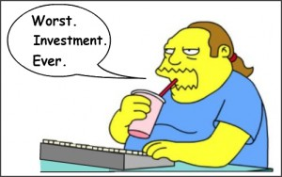

return on investment
Notes:
3:37 – 3:37pm
Danielle 30 sec.
So now you have data/research, and recommendations, but that still might not be enough to build the case for why your foundation or nonprofit should be developing a communications plan specifically to engage the Hispanic community.
I mean, if word of mouth is working so great and nonprofits are already at capacity, why invest limited resources in communications? Bilingual staff time, human translation, video, microsites, radio air time – these things cost money, right?
Well, that brings us to ROI.
For some of you, ROI may be preaching to the choir, but for others, getting the funding for communications be a real challenge, so how do we build a case?

Slide 38
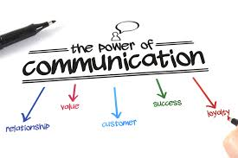
Notes:
3:38 – 3:40pm
Danielle 2 min.
#1. Have them listen to Andrew Belkin’s plenary presentation this morning!
#2. Well, one way to build a case in this area is capture the cost of not doing business.
No nonprofit likes to talk about inefficiencies of how they do their work, especially not to funders, but when asked, many nonprofits will share that lack of appropriate communications information about their services and programs leads them to spend countless staff hours fielding inquiries and conducting intake with individuals they cannot serve. It’s a loss of staff time, resources, and precious funding dollars better spent on services and programs – not to mention a lost of time for the mother who just dragged her kids across town and the damage it does to building trust in the community.
Sadly, many organizations absorb this as a “cost of doing business” because raising communications dollars on top of program dollars is challenging or seems impossible.
As funders we have to show more awareness and understanding here – investing in communications should go hand in hand with investing in program
#3. RETURN ON INVEST - the positive returns – see slide
Good communications…
Builds relationships and connection to community
Adds value to your work
Respects and better serves the individuals you are trying to reach
Leads to greater mission success
And positions an organization as a trusted source – something highly valued in the Latino community

Slide 39
Return on Investment
INVESTMENTS
Person to person
Build partnerships
Bilingual staff
Human translation
Microsites, mobile, video, & radio
Relevant outreach & intake
Women
RETURNS
Positive engagement
Expand network
Create ambassadors
Accuracy
Effective reach
More time to deliver services
Supports staff efforts
Notes:
3:40 – 3:42pm
Danielle 2 min.
PERSON 2PERSON- In person contact or phones answered by a Spanish speaker are still the method of choice
BILINGUAL STAFF – Cost effective and helps build trusted source. People say this limits the hiring pool, but that’s a good thing, it’s still a good pool.
AUTO translate is not only inaccurate, but will most likely not capture the nuance of your org
MICROSITES – Tied to nuance, you may not need a mirror image of your English site in Spanish - Use the most relevant platforms and tools
MOBILE APPS, VIDEO, RADIO – Latinos are the highest mobile app user population in the country, CELL PHONES over LAPTOPS
NPR reported that Latinos are more likely than other Americans to watch online videos, but there hasn't been much of an effort to develop special content for them
RELEVANT – means researching your audience and developing appropriate materials (are you trying to reach newcomers, second generation, youth, seniors?)
WOMEN – we mentioned abuelitas because women are the center of the Latino household, whether the news goes to las madres, your aunties, madrinas, or abuelas, they are power brokers and key decision makers and information sharers in the community. Madrinas and promotoras models An investment in working with Latina women may be key to your communication strategy

Slide 40



Return on Investment
Notes:
3:43
Danielle 1 min.
Case Studies

Slide 41
The question is not whether we can afford to invest in communications,
but whether we can afford not to.

