Slide 1


El Camino:
The Road to Healthy Relationships
Notes:
The contents of this presentation are those of the author(s) and do not necessarily represent the official views of nor an endorsement by DC Health.

Slide 2
Lesson 1
Program Introduction and Values

Slide 3
Lesson 1.1
Program Introduction and Values

Slide 4
Goals of El Camino: The Road to Healthy Relationships
Know yourself
Learn a decision making tool
Understand how your relationships with friends, peers, and family influence the direction of your life “path.”
Practice skills

Slide 5
Group Agreements
Participate as much as you can.
You only have to share what you feel comfortable sharing.
Make comments that are encouraging and judgement-free.
One person speaks at a time—no interrupting.
It’s okay to disagree but do so in a respectful manner.
Treat others how you would like to be treated.
Listen.
When you are at the El Camino program, you only do work that is related to El Camino.
Have fun!

Slide 6
Key Message
Knowing your values will help you be the best version of yourself.

Slide 7
Lesson 1.2
Program Introduction and Values

Slide 8
Group Agreements
Participate as much as you can.
You only have to share what you feel comfortable sharing.
Make comments that are encouraging and judgement-free.
One person speaks at a time—no interrupting.
It’s okay to disagree but do so in a respectful manner.
Treat others how you would like to be treated.
Listen.
When you are at the El Camino program, you only do work that is related to El Camino.
Have fun!

Slide 9
Key Message
Knowing your values will help you be the best version of yourself.

Slide 10
Values and Definitions
Acceptance/Open-Mindedness: Open to new experiences, ideas, and people. Non-judgmental. | Authenticity: Being true to yourself. | Creativity: Thinking of new ways to do things. Using your imagination to create something artistic.
Kindness: Being friendly and respectful to other people. | Fame: Being known or talked about by many people. | Family: Caring about close relationships with your family.
Honesty: Being fair and truthful. | Humor: Being funny or making people laugh. | Leadership: Encouraging a group to get things done together.
Loyalty: Showing support for your friends, family, and/or the things you believe are important. | Persistence: Continuing to try even when something is hard. | Power: Being able to influence other people or events.
Prosperity/Wealth: Having money in your pocket. | Self-Control: Being able to control your impulses, words, and behavior. | Faith: Belief in a higher power or inner strength.

Slide 11
Vote with Your Feet
I love meeting new people!
Having my phone out in class isn't distracting to me.
Joking about people online doesn't hurt anybody.
If I see someone sitting alone, I'll go out of my way to include them.
If someone disrespects me, I have to get even.
I have at least one adult at school that I can go to with questions about anything.

Slide 12
Lesson 2
Personal Identity – What Drives You?

Slide 13
Lesson 2.1
Personal Identity – What Drives You?

Slide 14
Group Agreements
Participate as much as you can.
You only have to share what you feel comfortable sharing.
Make comments that are encouraging and judgement-free.
One person speaks at a time—no interrupting.
It’s okay to disagree but do so in a respectful manner.
Treat others how you would like to be treated.
Listen.
When you are at the El Camino program, you only do work that is related to El Camino.
Have fun!

Slide 15
Key Message
Deciding what, and how much, to share about yourself can affect your relationships.

Slide 16
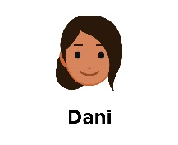

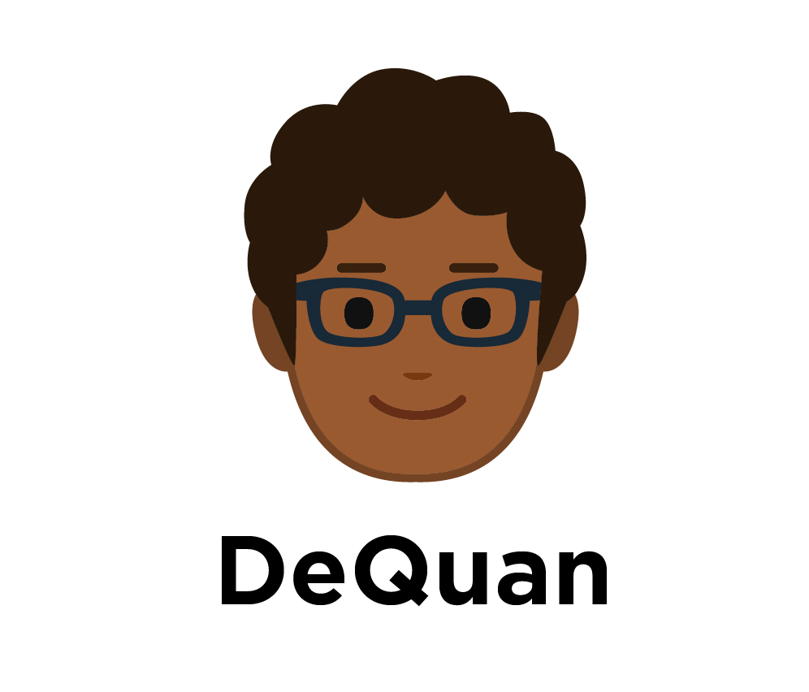
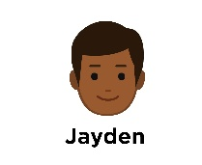
Character Values Chart
Character | Values | Evidence

Slide 17
Values and Definitions
Acceptance/Open-Mindedness: Open to new experiences, ideas, and people. Non-judgmental. | Authenticity: Being true to yourself. | Creativity: Thinking of new ways to do things. Using your imagination to create something artistic.
Kindness: Being friendly and respectful to other people. | Fame: Being known or talked about by many people. | Family: Caring about close relationships with your family.
Honesty: Being fair and truthful. | Humor: Being funny or making people laugh. | Leadership: Encouraging a group to get things done together.
Loyalty: Showing support for your friends, family, and/or the things you believe are important. | Persistence: Continuing to try even when something is hard. | Power: Being able to influence other people or events.
Prosperity/Wealth: Having money in your pocket. | Self-Control: Being able to control your impulses, words, and behavior. | Faith: Belief in a higher power or inner strength.

Slide 18
Lesson 2.2
Personal Identity – What Drives You?

Slide 19
Group Agreements
Participate as much as you can.
You only have to share what you feel comfortable sharing.
Make comments that are encouraging and judgement-free.
One person speaks at a time—no interrupting.
It’s okay to disagree but do so in a respectful manner.
Treat others how you would like to be treated.
Listen.
When you are at the El Camino program, you only do work that is related to El Camino.
Have fun!

Slide 20
Key Message
Deciding what, and how much, to share about yourself can affect your relationships.

Slide 21
Values and Definitions
Acceptance/Open-Mindedness: Open to new experiences, ideas, and people. Non-judgmental. | Authenticity: Being true to yourself. | Creativity: Thinking of new ways to do things. Using your imagination to create something artistic.
Kindness: Being friendly and respectful to other people. | Fame: Being known or talked about by many people. | Family: Caring about close relationships with your family.
Honesty: Being fair and truthful. | Humor: Being funny or making people laugh. | Leadership: Encouraging a group to get things done together.
Loyalty: Showing support for your friends, family, and/or the things you believe are important. | Persistence: Continuing to try even when something is hard. | Power: Being able to influence other people or events.
Prosperity/Wealth: Having money in your pocket. | Self-Control: Being able to control your impulses, words, and behavior. | Faith: Belief in a higher power or inner strength.

Slide 22
Lesson 3
Introducing STAR

Slide 23
Lesson 3.1
Introducing STAR

Slide 24
Group Agreements
Participate as much as you can.
You only have to share what you feel comfortable sharing.
Make comments that are encouraging and judgement-free.
One person speaks at a time—no interrupting.
It’s okay to disagree but do so in a respectful manner.
Treat others how you would like to be treated.
Listen.
When you are at the El Camino program, you only do work that is related to El Camino.
Have fun!

Slide 25
Key Message
The STAR decision making tool can help you make decisions that are in line with your values.

Slide 26
Stop
Think
Act on your values
Reflect

Slide 27
STAR Activity
Who does this decision impact?
How might your relationship with that person [those people] change depending on what you do or say?
Can any of the values that are “most important to you” help you decide what to do?
What would be the best outcome from your decision? [How do you want this situation to resolve?]

Slide 28
Lesson 3.2
Introducing STAR

Slide 29
Group Agreements
Participate as much as you can.
You only have to share what you feel comfortable sharing.
Make comments that are encouraging and judgement-free.
One person speaks at a time—no interrupting.
It’s okay to disagree but do so in a respectful manner.
Treat others how you would like to be treated.
Listen.
When you are at the El Camino program, you only do work that is related to El Camino.
Have fun!

Slide 30
Key Message
The STAR decision making tool can help you make decisions that are in line with your values.

Slide 31
Stop
Think
Act on your values
Reflect

Slide 32
Lesson 4
First: Stop

Slide 33
Lesson 4.1
First: Stop

Slide 34
Group Agreements
Participate as much as you can.
You only have to share what you feel comfortable sharing.
Make comments that are encouraging and judgement-free.
One person speaks at a time—no interrupting.
It’s okay to disagree but do so in a respectful manner.
Treat others how you would like to be treated.
Listen.
When you are at the El Camino program, you only do work that is related to El Camino.
Have fun!

Slide 35
Stop
Think
Act on your values
Reflect

Slide 36
Key Message
Noticing how you feel can help you STOP so that you can take the time to make a decision you feel good about.

Slide 37
Stress Responses
Nauseated/sick to stomach
Like there's a brick in stomach
Tightness in chest
Trouble breathing
Hot
Clenching fists
Sweaty hands
Pounding/racing heart
Shaky legs
Butterflies in stomach
Need to use the bathroom

Slide 38
Lesson 4.2
First: Stop

Slide 39
Group Agreements
Participate as much as you can.
You only have to share what you feel comfortable sharing.
Make comments that are encouraging and judgement-free.
One person speaks at a time—no interrupting.
It’s okay to disagree but do so in a respectful manner.
Treat others how you would like to be treated.
Listen.
When you are at the El Camino program, you only do work that is related to El Camino.
Have fun!

Slide 40
Key Message
Noticing how you feel can help you STOP so that you can take the time to make a decision you feel good about.

Slide 41
Stopping Strategies
Breathe slowly/stretch
Step away from the situation
Write/draw/other creative activities
Listen to music
Exercise/go for a walk
Talk to a friend

Slide 42
Lesson 5
Biology, Emotions, and Decision Making

Slide 43
Lesson 5.1
Biology, Emotions, and Decision Making

Slide 44
Group Agreements
Participate as much as you can.
You only have to share what you feel comfortable sharing.
Make comments that are encouraging and judgement-free.
One person speaks at a time—no interrupting.
It’s okay to disagree but do so in a respectful manner.
Treat others how you would like to be treated.
Listen.
When you are at the El Camino program, you only do work that is related to El Camino.
Have fun!

Slide 45
Key Message
Learning to manage your emotions can help you make decisions that are in line with your values.

Slide 46
Stopping Strategies
Breathe slowly/stretch
Step away from the situation
Write/draw/other creative activities
Listen to music
Exercise/go for a walk
Talk to a friend

Slide 47
Lesson 5.2
Biology, Emotions, and Decision Making

Slide 48
Group Agreements
Participate as much as you can.
You only have to share what you feel comfortable sharing.
Make comments that are encouraging and judgement-free.
One person speaks at a time—no interrupting.
It’s okay to disagree but do so in a respectful manner.
Treat others how you would like to be treated.
Listen.
When you are at the El Camino program, you only do work that is related to El Camino.
Have fun!

Slide 49
Key Message
Learning to manage your emotions can help you make decisions that are in line with your values.

Slide 50
Lesson 6
Empathy

Slide 51
Lesson 6.1
Empathy

Slide 52
Group Agreements
Participate as much as you can.
You only have to share what you feel comfortable sharing.
Make comments that are encouraging and judgement-free.
One person speaks at a time—no interrupting.
It’s okay to disagree but do so in a respectful manner.
Treat others how you would like to be treated.
Listen.
When you are at the El Camino program, you only do work that is related to El Camino.
Have fun!

Slide 53
Key Message
Empathy means understanding or identifying with another person’s feelings or experiences.

Slide 54
Am I empathetic?
I often think about other people's feelings.
I don't make fun of other people because I can imagine what it feels like to be in their shoes.
I listen to others about what they're going through.
I try to understand other people's point of view.
I am aware that not everyone reacts to situations the same way I do.

Slide 55
Lesson 6.2
Empathy

Slide 56
Group Agreements
Participate as much as you can.
You only have to share what you feel comfortable sharing.
Make comments that are encouraging and judgement-free.
One person speaks at a time—no interrupting.
It’s okay to disagree but do so in a respectful manner.
Treat others how you would like to be treated.
Listen.
When you are at the El Camino program, you only do work that is related to El Camino.
Have fun!

Slide 57
Key Message
Empathy means understanding or identifying with another person’s feelings or experiences.

Slide 58
Lesson 7
Assertive Communication

Slide 59
Lesson 7.1
Assertive Communication

Slide 60
Group Agreements
Participate as much as you can.
You only have to share what you feel comfortable sharing.
Make comments that are encouraging and judgement-free.
One person speaks at a time—no interrupting.
It’s okay to disagree but do so in a respectful manner.
Treat others how you would like to be treated.
Listen.
When you are at the El Camino program, you only do work that is related to El Camino.
Have fun!

Slide 61
Key Message
Assertive communication is an important tool for solving conflicts and maintaining healthy relationships.

Slide 62
Assertive Communication Techniques
I-Statements: “I____, when you____”
Calmly repeat yourself
Show empathy
Calm body language

Slide 63
Lesson 7.2
Assertive Communication

Slide 64
Group Agreements
Participate as much as you can.
You only have to share what you feel comfortable sharing.
Make comments that are encouraging and judgement-free.
One person speaks at a time—no interrupting.
It’s okay to disagree but do so in a respectful manner.
Treat others how you would like to be treated.
Listen.
When you are at the El Camino program, you only do work that is related to El Camino.
Have fun!

Slide 65
Key Message
Assertive communication is an important tool for solving conflicts and maintaining healthy relationships.

Slide 66
Assertive Communication Techniques
I-Statements: “I____, when you____”
Calmly repeat yourself
Show empathy
Calm body language

Slide 67
Lesson 8
Boundary Setting

Slide 68
Lesson 8.1
Boundary Setting

Slide 69
Group Agreements
Participate as much as you can.
You only have to share what you feel comfortable sharing.
Make comments that are encouraging and judgement-free.
One person speaks at a time—no interrupting.
It’s okay to disagree but do so in a respectful manner.
Treat others how you would like to be treated.
Listen.
When you are at the El Camino program, you only do work that is related to El Camino.
Have fun!

Slide 70
Key Message
Setting boundaries and respecting others’ boundaries is part of building healthy relationships.

Slide 71
Setting Strong Boundaries
Know your limits by listening to your body
Remember your values
Be direct
Practice and ask for help

Slide 72
Lesson 8.2
Boundary Setting

Slide 73
Group Agreements
Participate as much as you can.
You only have to share what you feel comfortable sharing.
Make comments that are encouraging and judgement-free.
One person speaks at a time—no interrupting.
It’s okay to disagree but do so in a respectful manner.
Treat others how you would like to be treated.
Listen.
When you are at the El Camino program, you only do work that is related to El Camino.
Have fun!

Slide 74
Key Message
Setting boundaries and respecting others’ boundaries is part of building healthy relationships.

Slide 75
Role Play Questions
What do you think Stacy should say to Henry?
How do you think Henry will respond?
What should Stacy say to Henry’s response?

Slide 76
Lesson 9
External Influences on Decision Making

Slide 77
Lesson 9.1
External Influences on Decision Making

Slide 78
Group Agreements
Participate as much as you can.
You only have to share what you feel comfortable sharing.
Make comments that are encouraging and judgement-free.
One person speaks at a time—no interrupting.
It’s okay to disagree but do so in a respectful manner.
Treat others how you would like to be treated.
Listen.
When you are at the El Camino program, you only do work that is related to El Camino.
Have fun!

Slide 79
Key Message
Start with YOU. Your own words and actions can be a positive influence on others.

Slide 80
Lesson 9.2
External Influences on Decision Making

Slide 81
Group Agreements
Participate as much as you can.
You only have to share what you feel comfortable sharing.
Make comments that are encouraging and judgement-free.
One person speaks at a time—no interrupting.
It’s okay to disagree but do so in a respectful manner.
Treat others how you would like to be treated.
Listen.
When you are at the El Camino program, you only do work that is related to El Camino.
Have fun!

Slide 82
Key Message
Start with YOU. Your own words and actions can be a positive influence on others.

Slide 83
Lesson 10
Bringing It All Together

Slide 84
Lesson 10.1
Bringing It All Together

Slide 85
Group Agreements
Participate as much as you can.
You only have to share what you feel comfortable sharing.
Make comments that are encouraging and judgement-free.
One person speaks at a time—no interrupting.
It’s okay to disagree but do so in a respectful manner.
Treat others how you would like to be treated.
Listen.
When you are at the El Camino program, you only do work that is related to El Camino.
Have fun!

Slide 86
Key Message
Taking the time to reflect on past decisions helps us know what we should do differently in the future.

Slide 87
Vote with Your Feet
It’s never too late to change my mind about a decision I’ve made.
Sometimes when I’m facing a difficult decision or relationship challenge, I talk to trusted friends or family members about it.
If I make a good decision, it should have a good outcome.
Sometimes I think back on my past decisions and how they have impacted other people.
If I’m not sure what decision to make, I just avoid making the decision.
There can only be one right choice in any decision I have to make.

Slide 88
Reflection Questions
Did you stay true to your values in the way you responded? (If yes, which values?)
How did things work out?
What would you do differently in the future, if anything? Why?

Slide 89
Lesson 10.2
Bringing It All Together

Slide 90
Group Agreements
Participate as much as you can.
You only have to share what you feel comfortable sharing.
Make comments that are encouraging and judgement-free.
One person speaks at a time—no interrupting.
It’s okay to disagree but do so in a respectful manner.
Treat others how you would like to be treated.
Listen.
When you are at the El Camino program, you only do work that is related to El Camino.
Have fun!

Slide 91
Key Message
Taking the time to reflect on past decisions helps us know what we should do differently in the future.

