Slide 1
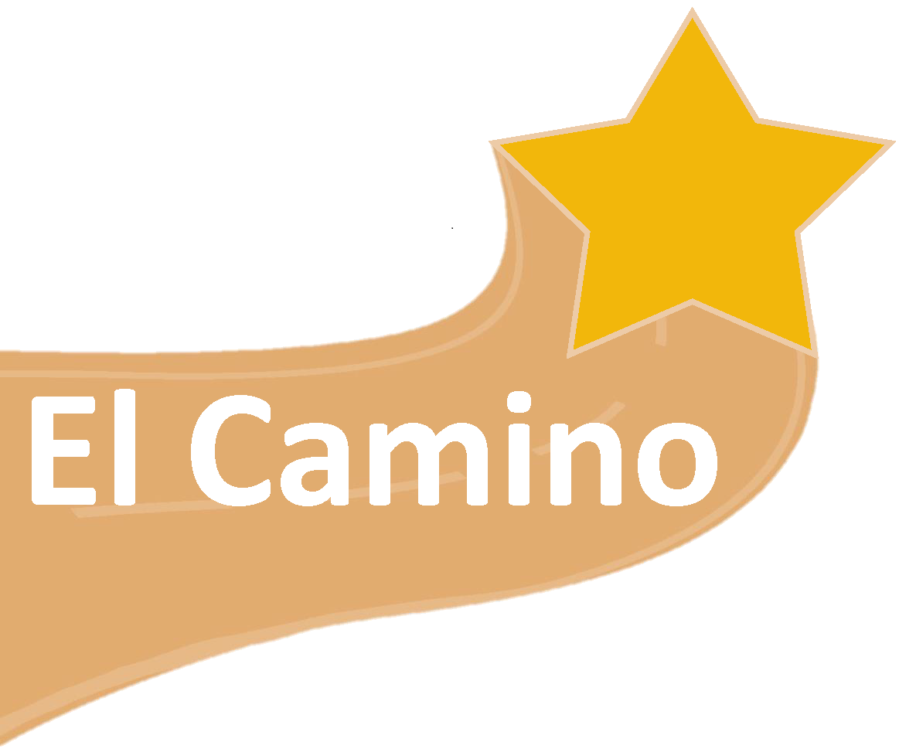

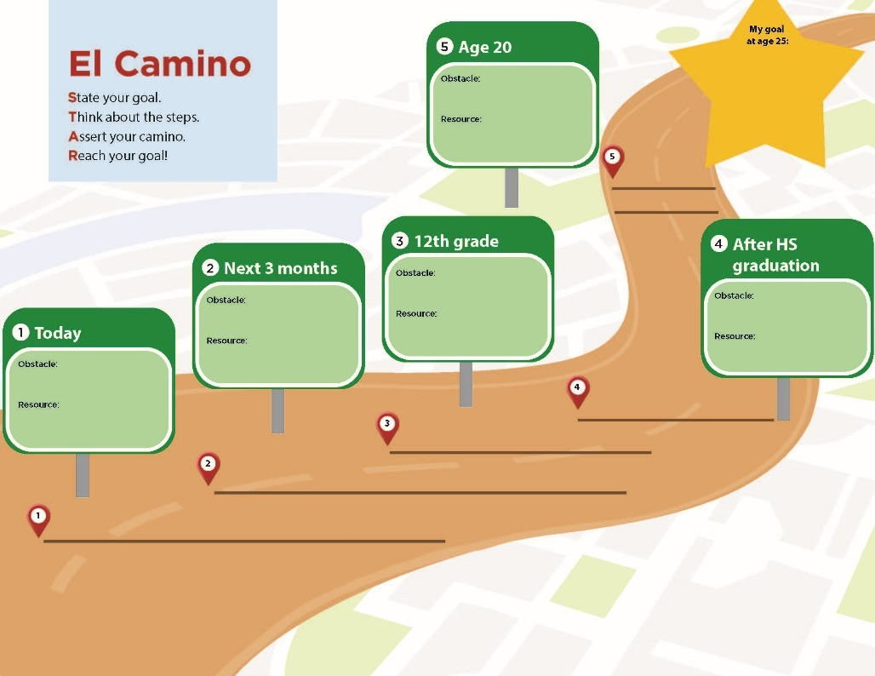
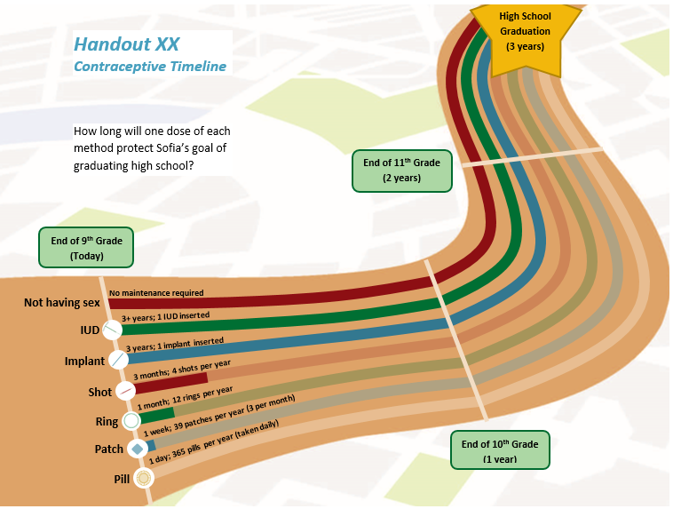
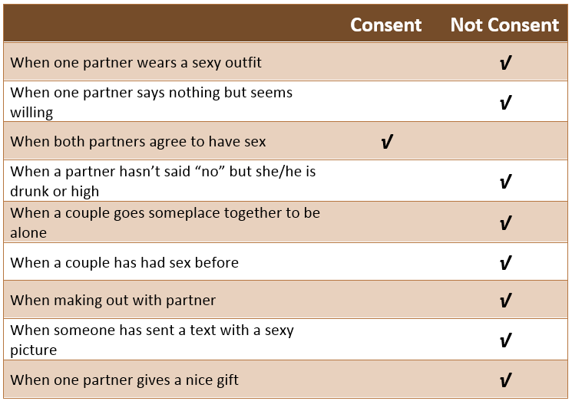




Reducing Teen Childbearing Among Latinos: An Innovative Anti-Poverty Curriculum
Kristin A. Moore, Jennifer Manlove, Lina Guzman, Shelby Hickman, Jenita Parekh, Bianca Faccio, Selma Caal, Miranda Carver Martin, Kelly Murphy, Sam Beckwith
Background
El Camino Structure
Findings
Based on literature reviews and interviews with Latino adolescents and parents, we found:
Contrary to some perceptions, most Latino teens do not want to become parents during adolescence.
Teenage pregnancy interferes with educational goals and can perpetuate intergeneration poverty.
The Latino community values education highly, but young people need support to gain skills to achieve their educational goals and avoid early pregnancy.
We first reviewed research and programs on Latino adolescents, and conducted interviews with teens, parents, program evaluators, and providers who have modified teen pregnancy prevention programs for Latinos. In consultation with content experts and drawing on observations, student focus groups and surveys, and facilitator feedback, we have conducted five rounds of curriculum revision to fine-tune the program.
El Camino helps teens identify positive life goals and develop the knowledge, attitudes, behaviors, and relationships to avoid teen pregnancy and reach their goals. El Camino is organized in three sections or “arcs”:
Students answered questions drawn from the Federal PREP surveys on their perceptions of how El Camino affected their behaviors and attitudes.
90% of students said they were less likely to have sex and more likely to use a condom or birth control.
  More than half of students (56%) said they think it made them less likely to have sex
  Close to two out of three students (61%) said it made them more likely to use contraception
  Nearly three out of four students (70%) said it made them more likely to use condoms
Three-fourths of students rated El Camino as “excellent” or “very good”
Other pre-post changes include the following:
Culturally-Relevant Program in Context of Educational Achievement
1
Arc 1: Identifying, tracking, and protecting goals
The El Camino road map helps students identify short- and long-term goals and steps toward achieving those goals using STAR:
State your Goal
Think about the Steps
Assert your Camino
Reach your Goal
These lessons also help students talk about dating, sex, and avoiding road trips that may take them off their camino.
Reduced Exposure to Unprotected Sex
Theory of Change
Increased Educational Attainment
Lowered Risk of Poverty
A program that facilitates positive peer, parent-child, and partner relationships, and emphasizes that reducing the risk of teen pregnancy in the context of high educational achievement and academic supports will reduce exposure to unprotected sex. This will be achieved by either increased abstinence or improved contraceptive use, which will then reduce early pregnancy and thereby increase educational attainment and lower the risk of poverty.
2
Arc 2: Understanding reproductive biology, contraception, and condoms
This arc covers male and female reproductive health and contraceptive methods, including condoms and hormonal and long-acting contraceptive methods. In response to feedback, we added a question box so students have an opportunity to write questions anonymously, to be answered by the teacher the next day.
Demographics
El Camino has been implemented in five locations to date with a diverse group of more than 320 students (survey data were collected from over 120 students):
3
Washington, DC
East Chicago, IN
Tacoma, WA
Baltimore, MD
Los Angeles, CA
Arc 3: Building effective communication and healthy relationships
This arc helps students build assertive communication skills with a focus on healthy relationships. Students discuss how different relationship characteristics may make it harder to communicate assertively. In the latest round of revisions we also added information to the curriculum about consent.
Acknowledgements
Age: 14-20 years old; 16 years on average
Gender: 57% female, 42% male
Race/Ethnicity: 71% Hispanic, 22% black, 2% multiracial, 5% another race
Sexually experienced: 44% of students reported they ever had sex at the time of pre-test
We thank the JPB Foundation for its generous support, as well as our curriculum writers, expert advisors, and staff from our partner schools.
sbeckwith@childtrends.org

