Slide 1
Evaluation of the Re:MIX teen pregnancy prevention program for Latinx youth
Jennifer Manlove, PhD
Kate Welti, MPP
Jane Finocharo, BA
Bianca Faccio, BA
Samantha Ciaravino, MPH
Brooke Whitfield, BA

Slide 2
The Re:MIX program
Comprehensive and inclusive school-based sex education program.
Aims to educate and empower adolescents and ultimately reduce rates of unplanned pregnancy and STIs. Also aims to promote equitable gender attitudes.
Ten 55-minute sessions, implemented once a week.
Young parent peer educator model - the curriculum is facilitated by young parents paired with professional health educators.
Incorporates storytelling, technology, and game-based tools.

Slide 3
The Re:MIX curriculum sessions
SESSION 1 - Introducing Re:MIX
Introduces the curriculum and the storytelling approach.
SESSION 2 - Getting the Gender Message
Discusses, questions, and redefines gender norms collectively.
SESSION 3 - Understanding Relationships
Builds participants’ skills to identify healthy and unhealthy relationships.
SESSION 4 - That’s What I’m Talking About!
Explores strategies for youth to communicate effectively and safely.
SESSION 5 - Consent and Setting Limits
Defines individual sexual rights and responsibilities, while youth practice communicating consent.
SESSION 6 - Becoming an Adult
Explains adolescent development and the reproductive process.
SESSION 7 - Condoms and Contraception
Teaches youth about accessible and effective contraceptive methods.
SESSION 8 - The Final Stage
Discusses facts about sexually transmitted infections and how to make safe sexual health decisions.
SESSION 9 - A Baby Today
Explains the financial implications of childrearing through games and storytelling.
SESSION 10 - Commitment to the Future
Encourages youth to envision their ideal futures and identify goals that will empower them to lead healthy lives.

Slide 4
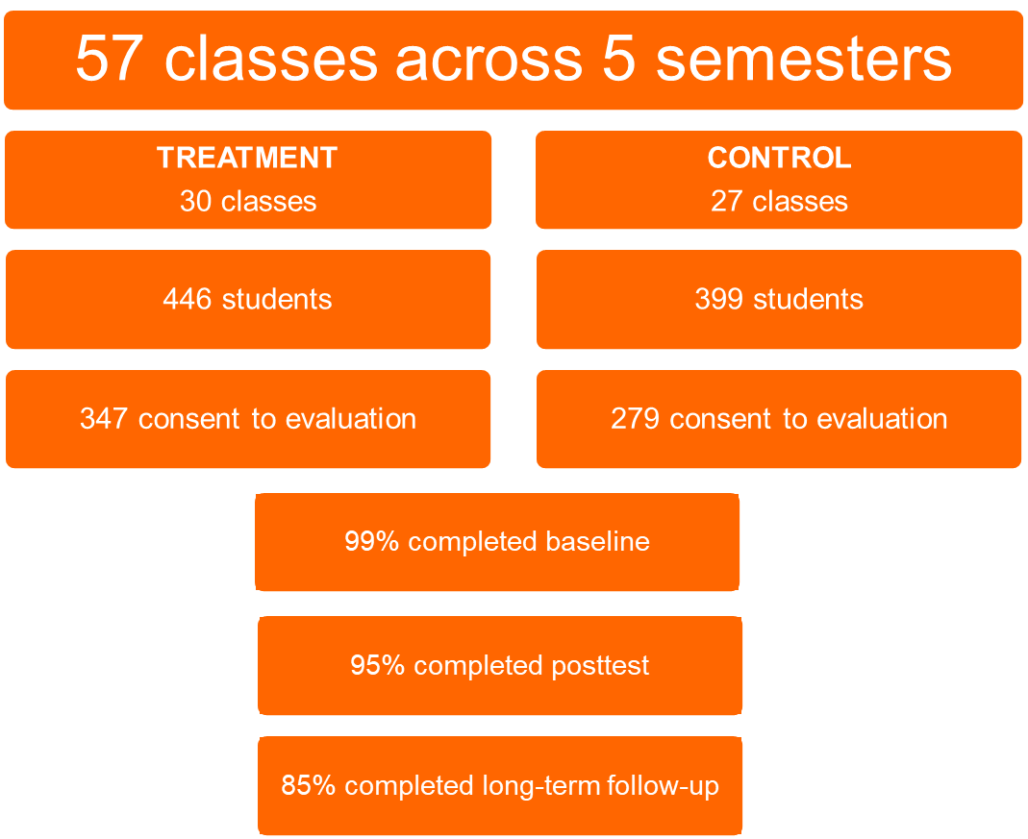
Evaluation Design
Conducted in three schools in Texas with primarily Latino students.
Implemented with students in 8th-10th grade.
Participants completed a baseline survey, a posttest survey at the end of the program, and a long-term follow-up survey approximately 12 months after the program ended.

Slide 5
Participant Characteristics
Race/ethnicity
71% Hispanic/Latinx
15% non-Hispanic white
7% non-Hispanic black
7% non-Hispanic other
Language spoken at home
41% speak Spanish
53% speak English
Parental education
36% have mothers with less than a high school education
34% have fathers with less than a high school education
Children of teen parents
29% are children of a teen mother
19% are children of a teen father

Slide 6
Implementation Findings
Performance Measures
90% of students participated in at least 8 of the 10 sessions
29% of classes were observed
4.1 average quality rating (out of 5)
Student Experience
98% said they learned something from Re:MIX
78% would recommend Re:MIX
89% liked health educators
90% liked young parent peer educators

Slide 7
Impact Findings
We found short-term mediating impacts on intentions to use effective contraception, reproductive health knowledge, and self-efficacy.
All findings were sustained at long-term follow-up, except for contraception intentions.
There were no significant impacts on sexual experience or unprotected sex.

Slide 8
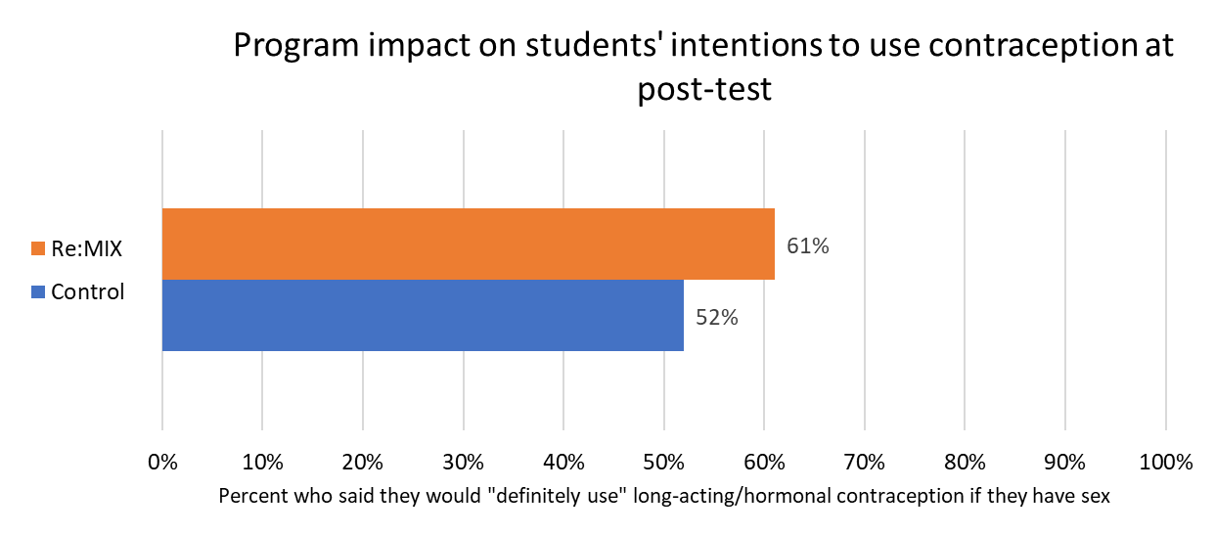
Post-test Impact Findings: Intentions
Among Re:MIX students, 61% reported on the post-test that they would “definitely” use hormonal or long-acting contraception if they have sex in the next year, compared to 52% of control group students.
This finding was not sustained at long-term follow-up.

Slide 9
Post-test Impact Findings: Knowledge
Contraceptive efficacy
Re:MIX students provided a higher percentage of correct answers to questions about condoms, STI prevention, and contraceptive efficacy. These impacts were sustained at long-term follow-up.

Slide 10
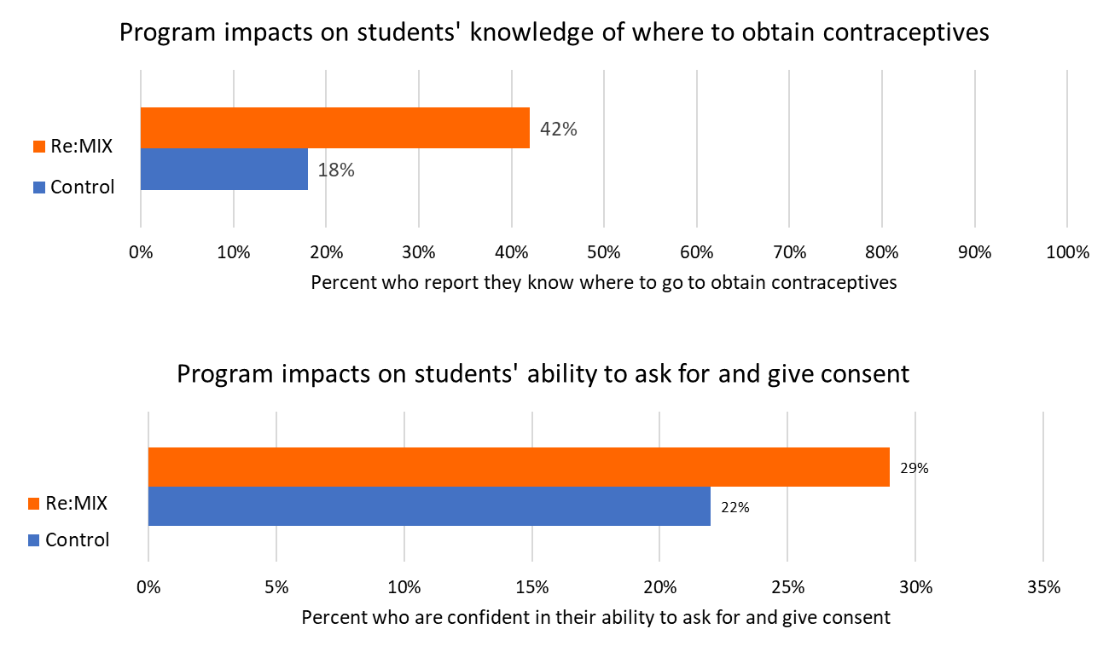
Post-test Impact Findings: Self-Efficacy
Re:MIX students were more likely than control group students to report that they knew where to go to get contraceptives and that they were confident in their ability to ask for and give consent. These impacts were sustained at long-term follow-up.

Slide 11
Summary and Discussion
Although we did not find impacts on behavioral outcomes, our findings related to self-efficacy, knowledge, and intentions suggest Re:MIX has promise with Latinx students.
Students rated both young parent educators and adult health educators highly, highlighting benefits of the young parent peer educator model.
We were not powered to detect program impacts on unprotected sex because very few students reported being sexually active. Our sample was young (average age 14) and sexually inexperienced at baseline. Even at long-term follow-up, very few students were sexually active. Future studies should consider implementing Re:MIX with older students and using longer follow-up time periods to better assess behavioral impacts.

Slide 12
Acknowledgements
We would like to thank Monica Armendariz, Rebecca Shirsat, Jenifer DeAtley, Melissa Pintor Carnagey, and Tracy Parks of EngenderHealth for their work developing and implementing Re:MIX.
This presentation was made possible by grant number TP2AH000033-01-02 from the Office of Population Affairs (formerly the Office of Adolescent Health), US Department of Health and Human Services (HHS). Its contents are solely the responsibility of the authors and do not necessarily represent the official views of the Office of Population Affairs or HHS.

