Slide 1
Pulse: Evaluating a pregnancy prevention mobile app for older adolescents nationwide
Elizabeth Cook, MSPH
Jennifer Manlove, Ph.D.
Makedah Johnson, B.S.
Child Trends

Slide 2


Overview
Evaluation study context
Enrolling participants
Addressing scammers
Our sample and next steps

Slide 3

What is Pulse App?
A self-led, web-based mobile sexual and reproductive health app intervention for young Black and Latina women developed by Healthy Teen Network and Meta Media.
Goals
To increase…
    the use of highly effective contraceptives and
    visits to sexual and reproductive health clinics
… among young women in the United States.
Notes:
Similar to Crush app but targets a slightly older audience (18-20 yo) who are usually missed by traditional teen pregnancy prevention efforts, which are usually administered in schools. Best way to reach this group, especially racial and ethnic minorities, is outside our typical programmatic environment.

Slide 4
Context of
Evaluation Study

Slide 5





Pulse Evaluation
Funded by U.S. Department of Health and Human Services’ Office of Adolescent Health
Two-arm randomized controlled trial
Pilot tested in 2016
Mirrored apps for treatment and control groups
6-week intervention:
access to app
unidirectional MMS text messages

Slide 6

Pulse Evaluation
Social media recruitment
Data collection
baseline survey (online)
immediate post-intervention survey (online)
in-depth phone interviews
app usage
text messages

Slide 7





Partners
App development and advertising
Evaluation
App development and hosting
Data collection and retention
Text messaging
Notes:
Compared to Crush, the Pulse Evaluation has had more partners, and each one took on a different role. The two main partners are at the top: Healthy Teen Network developed the app and oversaw social media advertising, and Child Trends is leading the evaluation. We were supported by three other groups.
So let’s talk about recruitment now.
[Additional detail, if needed]
Healthy Teen Network
Co-developed app and managed social media advertising
Child Trends
Led evaluation and collected qualitative data, set up text messaging campaigns, developed surveys, and conducted all data analyses
Meta Media
Co-developed and hosted app
Ewald & Wasserman
Oversaw randomization process, collected quantitative data, and mailed incentives
EZ Texting
Text messaging service

Slide 8





Sample Eligibility Criteria
Female
Aged 18-20
Living in U.S. or territories
Not pregnant or trying to become pregnant at baseline
Daily access to smartphone

Slide 9

Recruitment
Goal: at least 70% Black and/or Latina
N =1,304
Recruited participants November 2016 to October 2017
Notes:
END of slide:
Recruitment process generally similar to Crush
Young Black and (especially) Latina 18-20 year old women are a difficult to reach population online, took work!
Cost: started at $146 per person and ended at ~$3 per person

Slide 10
Enrolling Participants
Notes:
Next, I’d like to share some lessons learned from our online enrollment process.

Slide 11
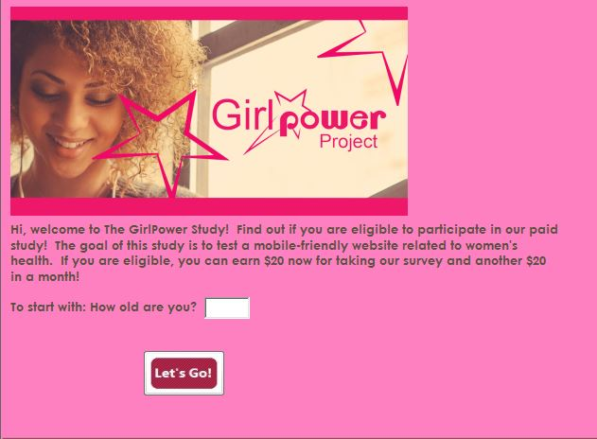
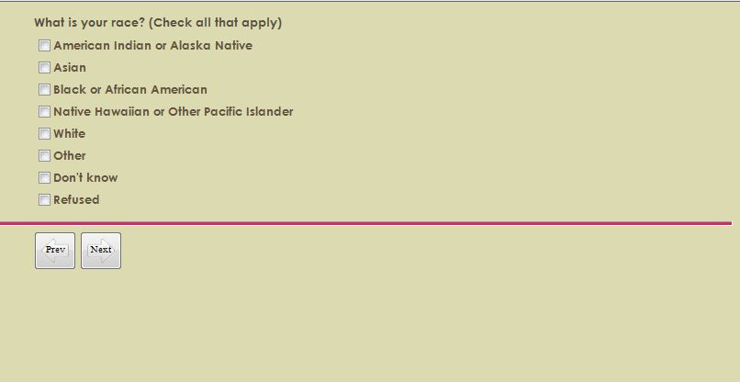
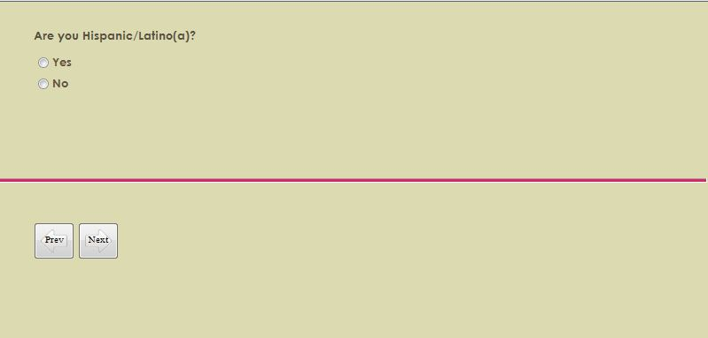
Pilot enrollment process
Online ad
Study Landing Page
Multi-page screener
Notes:
Our enrollment process included several steps. For the pilot study, we started with the online ad, which then sent people to the study landing page that included the first screener question (left image). Then they proceeded through a multi-page screener, which had one question on each page (examples in middle and right images). If they met our eligibility criteria, they then proceeded on. Key takeaway is that the design is very basic.

Slide 12
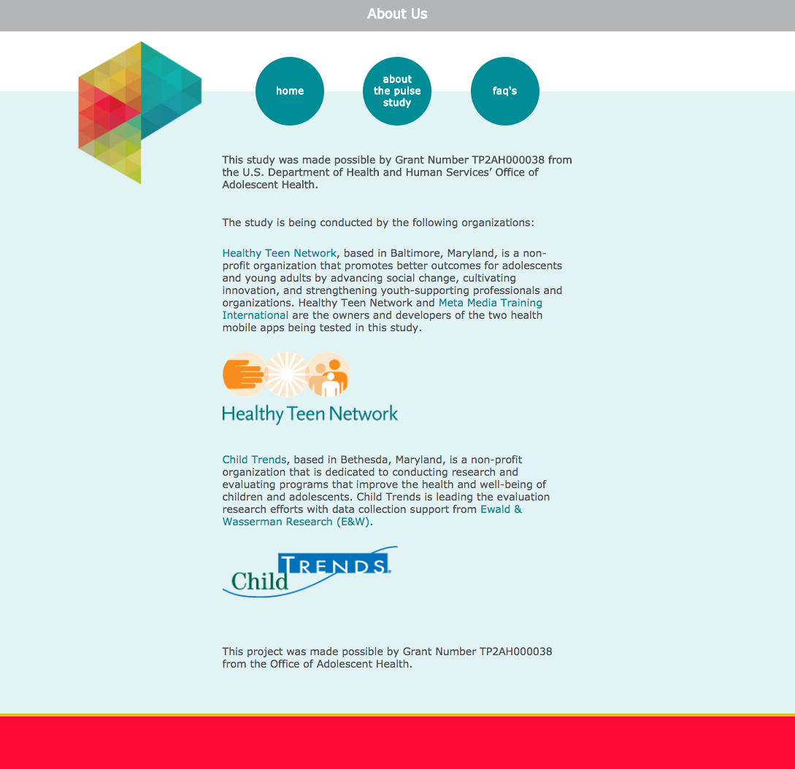
Early enrollment process
Notes:
After the pilot, we decided to create a study website with information about the partners and our funding to make the study seem more legitimate (since we never had individualized contact with our participants), so in the early stages of the RCT, we routed people who clicked on the social media ad straight to our study website. The image here is the About Us page from the website. Unfortunately, when we sent potential participants from the ad to our website, only 7% went on to the screener page (e.g., for November 28- December 31, 1400 visited the landing page and only 100 of them went on to take the screener). As a result, we decided to send everyone directly to the screener page – they could then look at information about the study or FAQs if they were interested in getting more information

Slide 13
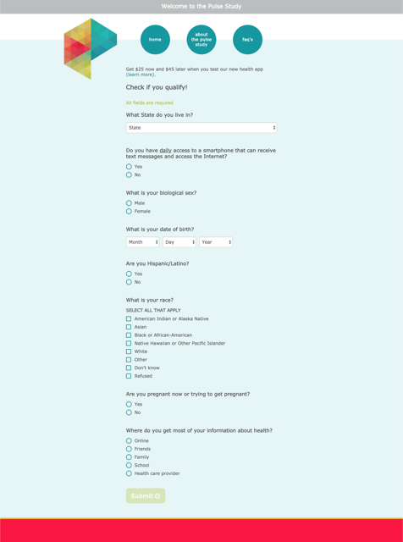
Final version of screener
Notes:
We also decided to put all of our screener questions on one page. So the image on the left is one of the screener pages from the pilot version that you’ve already seen, and the image on the right is our final, one-page screener. The website is available via the circles at the top.
So how did this change go?
Before we put the screener questions all together on one page, only 10% of those who landed on the first screener page went on to Question 2 on the next page. Of those who started the screener at all, only 7% completed it.
In contrast, after putting all of the questions on one page, more than 90% of those who went to the screener page completed the screener (97% went to the 2nd question and 94% completed it).

Slide 14
Final enrollment process
Online ad
One-page screener
Randomized
Consent / Enrollment
Baseline Survey
Notes:
All steps occur automatically online
Final enrollment process: 8 of 11 months (March – October)
Summary stats (January - October)
~14k views of the screener (made it to the screener)
~1,260 views of FAQs page
~500 of About Us page

Slide 15
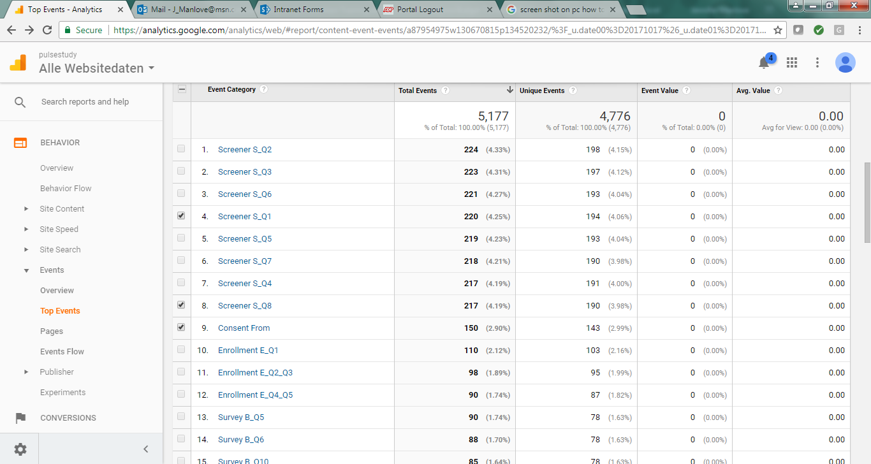
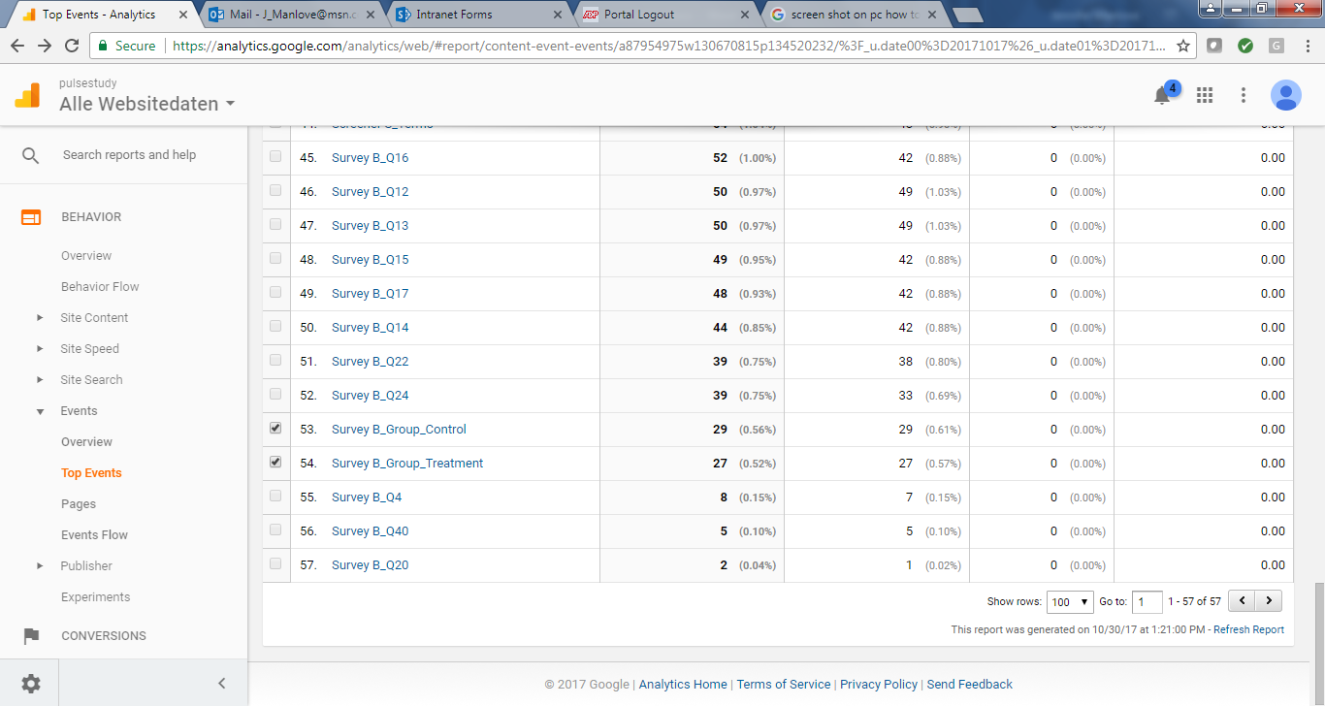
Tracking enrollment using Google Analytics
Notes:
We used Google Analytics to track people’s progress through the enrollment process. It turned out to be a great resource for identifying points at which people were dropping off. This slide shows a single day of recruitment where we had:
224 people answer the second screener question, 217 finish the screener, and 56 randomized (at the bottom)

Slide 16
Treatment vs. Control Experience
Notes:
Once participants were enrolled in the study, we wanted to give them comparable experiences so that we wouldn’t have differential attrition, meaning we would have a higher rate of one group dropping out of the study compared to the other.

Slide 17
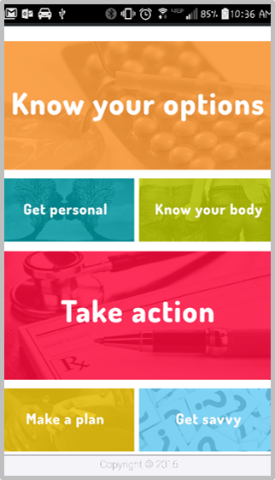
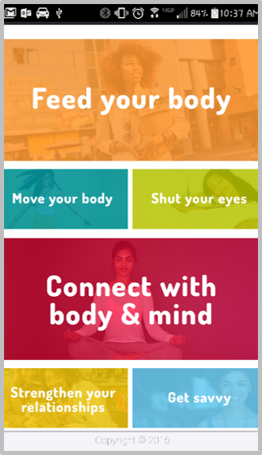
Similarly designed apps
Treatment
Control
Notes:
We did our best to create a similarly designed app for the control group that was focused on general wellness rather than sexual and reproductive health specifically.
Pulse, the treatment app, ended up having much more depth than the control app, but they both functioned similarly and were non-linear so the participant could click around to what interested them.

Slide 18
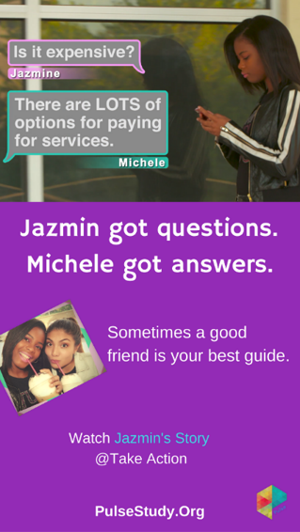

MMS prompts
Treatment
Control
Notes:
Both groups received text messages. Here are two examples of the MMS messages we sent to participants.

Slide 19

Incentive timing
Notes:
Our original design was that, in addition to taking the baseline survey, we required participants to view some content in all six sections of their particular app in order to get the first incentive, which was a $25 check. We started noticing that treatment group participants were not qualifying for that incentive as much as the control participants, and when they did, it tended to be later in the intervention than control participants. This may have been because the treatment app had a lot more content so it was easier to stay in a couple of sections and still consume the same amount (or more!) as someone who viewed the entire control app. We adjusted our incentive requirement several times and eventually sent the incentive halfway through the intervention to anyone who registered with their app during that period, regardless of whether they actually consumed any content.

Slide 20
Received first incentive
(N=1,304)
Notes:
Out of our entire sample (1304), 85% (1114) participants received the first incentive. It was almost identical for treatment and control.

Slide 21
Notes:
About half of our sample met our initial usage requirements and received an incentive within the first week or two of the intervention. 33% of treatment and 71% of control participants who received the first incentive received it early. That’s a huge difference that we think can be explained by some of the factors already discussed, particularly that the control app takes much less time to view.

Slide 22
Scammers & Duplicates
Notes:
So we put all this work into recruiting and enrolling participants, and making sure they have comparable experiences, but I haven’t addressed the huge issue that researchers face when we conduct an evaluation without ever meeting our participants: scammers and duplicates. What do I mean by scammers and duplicates?

Slide 23
Scammer – does not meet our eligibility criteria on first screener attempt but tries to pass the screener again
Duplicate – meets our eligibility criteria on first screener attempt but tries to pass the screener again
IP address
Name
Telephone number
Birth date
Address for incentive
Notes:
We defined scammers as … and duplicates as … Not all had ill-intent. Some was unintentional.
What might we use to identify scammers and duplicates? IP address…
Our screener and enrollment system was automatic so people could join the study at all hours of the day and night, but our system could not automatically detect scammers/duplicates. So we set up a protocol to manually review the screener attempts for this kind of behavior several times per week. As you might imagine, this was a time-consuming process, but we didn’t want to recruit a bunch of people who were outside of our target group and have to drop them later on.
We have two examples to share with you, but there are myriad scenarios that are possible.

Slide 24
Scenario #1: Obvious Scammer
ID | IP | Timestamp | Age | Group | State | Month of Birth | Date of Birth | Year of Birth
10 | 11.22.333.444 | 10/26/2017 11:01 | 35 | ineligible | NY | 10 | 1 | 1982
11 | 55.32.511.414 | 10/26/2017 11:10 | 20 | control | MD | 9 | 1 | 1997
12 | 11.22.333.444 | 10/26/2017 11:15 | 15 | ineligible | NY | 10 | 1 | 2002
13 | 11.22.333.444 | 10/26/2017 11:27 | 19 | treatment | NY | 10 | 1 | 1998
Notes:
Here is an example of an obvious scammer.
FAKE DATA and only a handful of the variables we actually had access to
format is the same as how our screener reports appeared
We have an ID number, IP address...
The first row (ID 10), is the earliest screener attempt shown, and the bottom row (ID 13) is the most recent attempt shown.
You can see that ID 10 is a 35-year-old person, then ID 11 is someone else, and then ID 12 is the same IP address as ID 10, same state, same month and day of birth, but the year changes. So this is probably someone who is attempting to adjust their age to meet our unknown eligibility criteria until they are successfully randomized (ID 13). In this case, we would have contacted and dropped ID 13 from our sample within the next few days because they were a scammer.

Slide 25
Scenario #2: Obvious duplicate
ID | IP | Timestamp | Age | Group | State | Month of Birth | Date of Birth | Year of Birth | First Name | Last Name | Email
20 | 12.34.567.8910 | 9/1/2017 10:02 | 19 | treatment | VA | 6 | 26 | 1998 | Naomi | Brown | naomib@abc.com
21 | 55.55.777.777 | 9/1/2017 20:28 | 22 | ineligible | NC | 12 | 13 | 1994
22 | 12.34.567.8910 | 9/3/2017 22:15 | 19 | treatment | VA | 6 | 26 | 1998 | Naomi | Brown | naomib@abc.com
23 | 12.34.567.8910 | 9/4/2017 12:54 | 19 | control | VA | 6 | 26 | 1998 | Naomi | Brown | naomib@cde.com
Notes:
This example shows an obvious duplicate (again, fake data). ID 20 is a person who successfully passed our screener on her first attempt (as seen in the group column). Then she came back twice several days later, tried again, and was successful. In this case, we would have kept ID 20 in our sample but dropped IDs 22 and 23. Some people came back even months later.

Slide 26
Scammers and duplicates
4,029
completed screener attempts
1,588
met eligibility criteria
284
were scammers/duplicates
1,304
participants in final sample
Notes:
“Attempts” does not mean “individuals”
Even with very targeted advertising, we still had to remove almost 20%, or 1 in 5, of the people who passed the screener and were randomized.

Slide 27
Our Sample

Slide 28
Race & Hispanic Ethnicity
Notes:
Highlight how difficult it could be to reach such a r/e diverse sample online.

Slide 29
Highest educational attainment
Participant
Parent
66% in college
or technical school
59% some college
or more
Notes:
Our sample was highly educated.

Slide 30
Baseline sexual experience
68% ever had sex
56% sex in past 3 months
77%
no condom
49%
no hormonal
birth control
44%
no method
Notes:
This is a high-risk sample
FULL sample stats:
56% had sex in last 3 months
25% had sex in last 3 months without any method
43% had sex in last 3 months without a condom
28% had sex in last 3 months without hormonal birth control
Stats among those who have had sex ever/sex in past 3 months:
82% had sex in last 3 months (among those who have ever had sex)
44% had sex in last 3 months without any method (among those who had sex in past 3 months)
77% had sex in last 3 months without a condom (among those who had sex in past 3 months)
49% had sex in last 3 months without hormonal birth control (among those who had sex in past 3 months)

Slide 31
Next Steps

Slide 32
Next Steps
Beginning to conduct impact analyses using our 6-week follow-up data.
Pursuing funding opportunities to:
evaluate the Spanish-language Pulse, and
further analyze our English-language survey data and app usage data.

Slide 33
Contact Us
Elizabeth Cook
ecook@childtrends.org
Jennifer Manlove
jmanlove@childtrends.org

