Slide 1

Social Media Training: Expand Your Career
Notes:
Welcome! Thanks for joining this professional development training, we will be recording this webinar. Thanks for taking the time to learn a little bit more about how you can use social media in your professional life. My name is Sara Appel and I am part of the communications team at the National Research Center on Hispanic Children and Families. Today, I’ll be joined by my colleagues Joseph Boven and Lorena Aceves who will be providing some social media tips and hints as well as a demonstration of how social media can be used to build your reputation and grow an audience for your work.

Slide 2
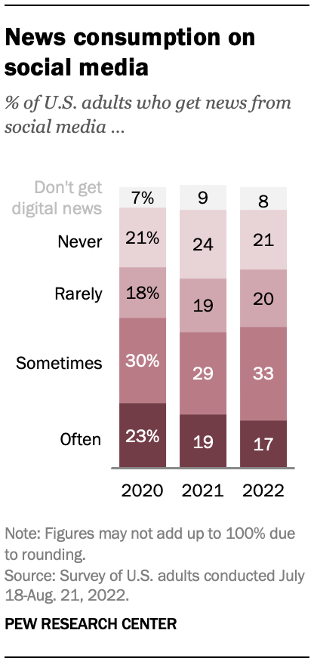
Why Social Media
It is where people are:
Over 302 million people (72% of U.S. residents) use social media in the United States as of 2022, and that number is projected to grow to 327.22 million by 2027.
It is how they learn about what is happening
71% Receive News at least sometimes on Social Media https://www.pewresearch.org/journalism/fact-sheet/social-media-and-news-fact-sheet/#who-consumes-news-on-each-social-media-site
Notes:
Before we delve into the nitty gritty, let’s take a moment to ask ourselves why using social media is important for our growth in the research field and the communication of our research.
Put simply, social media is where people are at, its where they find information, and it is where they share information. A recent Pew Research Center report found that 302 million or 72% of U.S. residents use social media as of 2022. And that number is expected to grow to 327.22 million by 2027. Further, roughly 70% of U.S. adults use social media to consume news at least occasionally and 50 percent do so often.

Slide 3
Why You Need Social Media
Share work
Build relationships and establish a community
Build your reputation or personal brand
Grow your professional opportunities
Increase the visibility, engagement with, and use of your research
Notes:
So what does this mean? It means that social media offers access to a large population of people who are regularly looking for and consuming information they actively care about and will leverage in their work, lives, and in the building of their own online communities.
This creates the ideal space for you to share your work, build Relationships, establish a community, and build your reputation and personal brand. Social media can also provide you with opportunities to grow professionally all while enhancing the visibility, engagement with, and use of your research.

Slide 4
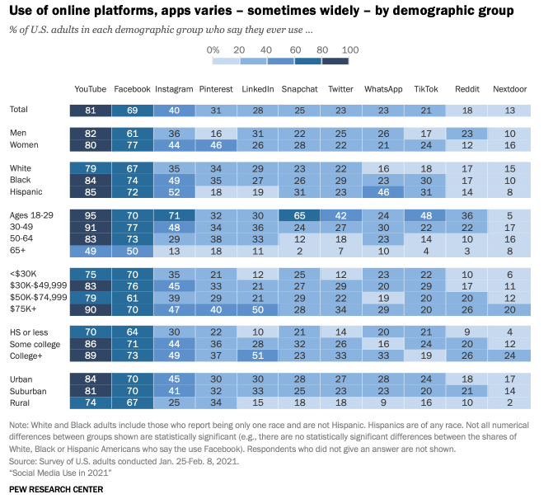
Social Media Platforms
Facebook
Twitter
Instagram
LinkedIn
TikTok
Snapchat
Pinterest
YouTube
Reddit
Google Scholar
Research Gate
More…
Notes:
There are a lot of platforms that we can choose from to share your research and build your professional reputation.
You are likely aware that Facebook, Twitter, Instagram, LinkedIn, Snapchat, Pinterest, and TikTok
But YouTube, RedIt, and Google Scholar can also be considered social media platforms and offer opportunities to share content and build your reputation. There are even platforms like ResearchGate that are designed specifically for the research community.
While we don’t have time today to go through the data for all of the platforms today, you should know that each speaks to different demographic categories of people. Whether we are talking about race and ethnicity, sexual identity, income level, or locale, knowing who uses which social media channel and why they use it can be helpful to chose the correct social media platform and to help tailor your messaging and content.
To garner more information on this, the PEW Research Center is constantly adding new data on this topic that is ever useful in helping to determine which platforms to reach people on.

Slide 5
Social Media Platform Selection
We chose the social media platforms discussed today based on the…
  Objective: Impact research, policy, and practice through your research
  Goal: Improved reputation, audience is made aware of, engage with and use research
  Audience: Researchers, Policymakers, Administrators, and Practitioners
  Content: Research and publications
Notes:
In selecting the social media platforms to share with you today, we chose platforms that will help you enhance the impact of your work in the research, policy, and practice communities and by building your professional reputation and encouraging policymakers, researchers, administrators, practitioners, and journalists to be made aware of, engage with, and use your work. The platforms chosen, are ones used by this target audience and ones that will best facilitate the sharing of research that can lead to the growth of your personal reputation and professional career, which in turn bolsters the importance of your work in the eyes of your audience, again likely leading to greater engagement and use, and potentially impact.
Generally speaking, the audience we are considering today is comprised of individuals with a higher degree, mid-to-upper salary ranges, and those who fall into the age range of 26 to 60 years old.

Slide 6
Recommended Platforms for Researchers
Primary discussion: Twitter
Secondary discussion: LinkedIn, Facebook, Google Scholar, Research Gate
Notes:
Transition to Joseph – Joseph Boven will now discuss the various platforms that can help communicate your research and build your reputation.
Thanks.
So, as you just heard we are targeting some fairly specific goals, demographic characteristics, and content types to pair with our Social Media Platform. As a result, we are primarily going to focus on Twitter and its use while also providing a brief overview of LinkedIn, Facebook, Google Scholar, and Research Gate. We’ll explain more about how they meet our criteria as we describe each platform.

Slide 7
Platforms Less Broadly Suited for Researchers and not Covered Today
Instagram, TikTok, Snapchat, Pinterest
  Primarily visual
  Currently difficult to share links or disseminate content
  Fewer users fit target audience (Note: this may not be the case depending on the goal, age of researcher, etc.)
  Research is not the reason for users use
Mastodon and other emerging platforms
  Due to size of audience, general complexity, and unsure future
This does not mean you should not use them if they fit your objectives and goals!
Notes:
But before we do that, why are we discussing some of the other platforms that are out there. We do not plan on discussing Instagram, TikToc, Snap Chat, Pinterest or similar platforms that while useful for reaching specific audiences don’t capture the majority of our audience, don’t match our content, as they are primarily visual and do not provide easy ways to share research links, and aren’t where people go to get research or policy ideas.
Of course, there are other platforms, like Mastodon, where some robust communities are forming to share research, but their futures seem still undecided and are tied to the fate of Twitter as to whether they will gather a larger presence. Finally, Threads for Instragram started yesterday. I’ve created an account and use it, and it looks much like Twitter, though using Instagrams backend. We’ll let you know more as we learn more.

Slide 8
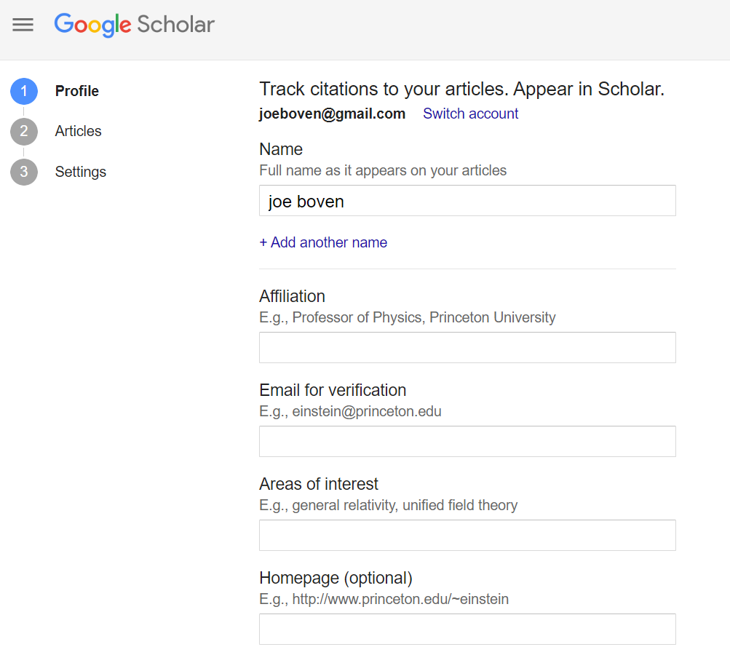
Google Scholar
Not exactly a social media platform…but important
Goal: Share Work/Garner Citations
Why: 80 percent of Academics said they used Google Scholar to conduct research
Who: Researchers, Policymakers, Journalists
How: Add a profile and description, add your publications, track your citations or download them
Notes:
As we mentioned, the main focus of today’s training will be on Twitter, however, we do want to provide a brief overview of some of the other social media sites that can be used to support your academic and professional career.
The first platform we’d like to discuss is Google Scholar. You are likely aware of its search engine capabilities, but you may also want to take a look at it as a social networking tool and potentially set up a profile on it. The research focused search engine offers over 300,000 publications and is used by over 80 percent of academics looking for publications for their research. This ultimately translates into citations, visibility, and the sharing by others of your work, which in turn helps you build your reputation. In addition, by creating your profile you can add your publications and ensure that Google Scholar includes them in its database, and as a bonus you’ll be able to track the number of citations your publications are receiving.

Slide 9
Platforms for You: Research Gate
Goal: Collaborate/Share Research to Build Reputation
Why: Social Networking for Researchers
Who: Researchers
How: Share your research, collaborate with your peers, and get the support you need to advance your career.
Notes:
Next, while limited to researchers, Research Gate is one of the few social networking sites just for you. By creating a profile, listing your focus areas and primary skills, and listing your publications, you’ll invite opportunities for others working in your field to reach out for collaborations. Likewise, the space provides an opportunity for you to reach out and learn from others. Generally, this will help you to build your reputation and open new doors in your professional carrier with just a little luck.

Slide 10
Platforms for You: Facebook
Goal: Publication engagement, sharing, and use with like minded individuals who care about the research and its outcomes
Why: Largest platform other than YouTube with 69% of U.S. adults saying they had ever used the program in 2021.
Who: Friends, family, colleagues and the people they know
How: Share important life and work events as a personal diary. People share and use things the adhere or enhance their sense of identity and the persona they want to project to others across a multiple formats.
Notes:
Facebook may not seem like the ideal spot to reach researchers, journalists, policymakers, and practitioners using a personal account, and it may not be unless they are your friends or connected to your friends on Facebook.
The bright side is that since Facebook is the largest standard social media platform capturing 69 percent of adults, and you are a researcher whose friends and colleagues are interested in similar work, it is likely that many of those in your target audience are already a Facebook friend.
As a result, if your goal is to have your publications engaged with, shared, and used, Facebook is a good place to cultivate a following and share.
So, how do you use Facebook then as a professional platform. The thing to know about Facebook is that people use it to project an identity that they want to share with the world. Their posts are often deeply personal to them with their content becoming an online diary for their friends and colleagues. This means that they will share, and often engage with content that matches their world view or enhances their sense of self, leading to high rates of blog post or report readership and sharing. By adding content that is meaningful to you and explaining the results of your research and why it matters, you followers will share your work.
Finally, Facebook offers more formats and tools to collaborate and reach like minded individuals than any other platform. Whether you want to create your own page, join a group on Latinx population research or present your cross-stitching techniques through Twitter live, Story, or Reel, the opportunities are plentiful. Maria talks about Latinx population Thanks, Maria. If we have time at the end, we’ll go into further Facebook hints and tips. We’ll also send these slides out to you so, that you can review them.

Slide 11
Platforms for You: LinkedIn
Goal: Build your reputation with colleagues and share research and skills
Why: Large array of professionals looking to learn new information and network. Made up of the demographic most likely to need, share, and use research.
Who: Researchers, Policy Makers, Practitioners, people in your field who have a college degree, make over $50,000 a year, and are within the age ranges of 18 to 65.
How: Build your personal brand and show case your thought leadership through the sharing of work and advice while growing your network.
Notes:
Linkedin is another platform that you should consider using if you do not already. It is a great site for helping reach the goal of building a reputation and brand as well as sharing content with professionals looking to learn new skills.
Twenty-eight percent of adults in the US say they use LinkedIn, and the platform is largely made up of professionals who have a college degree, make over $50,000 a year, with half earning over 75,000. In addition, a roughly equal number of users are within the age ranges of 18-29, 30-49, and 50-64. Additionally, these people are looking for ways to garner new skills, build knowledge, create networks, and advance their careers. In short, the population that you are looking to engage with.
This offers you an opportunity to strategically connect to the researchers, policy makers, practitioners, journalists and others working in your field, and, through using LinkedIn’s host of tools, to highlight your skills, share your work, and build connections while establishing your brand and self as a thought leader.
Like our Facebook Tips, we’ve provided a number of Tips and hints to use LinkedIn at the end of these slides and we can discuss them if you would like if there is time.

Slide 12
Platforms for You: Twitter
Goal: Build awareness and engagement of publications and build your community and reputation
Why:
  Researchers, policy makers, and journalists tend to focus on Twitter to disseminate and find content.
  Studies show that tweeting results in significantly more article citations over time - https://pubmed.ncbi.nlm.nih.gov/32251463/ Social and information scientists are over-represented on Twitter, compared with the U.S. workforce - https://www.nature.com/articles/nature.2017.21873
Who: Researchers, policymakers, journalists, practitioners
How: What’s happening now; usable, topic specific information for a topic specific audience. People look for and share what they feel is timely, relevant, and pertinent within the topic areas that matter most to them.
Notes:
Now….to Twitter.
The goal with Twitter is to build awareness, encourage sharing and engagement, and to grow a following of people interested in you and your research, which will build your reputation in the real worl and feed into both your professional progress and the sharing and use of your content.
These goals sound pretty similar to the other platforms, so why are we using Twitter. Primarily because it is where studies have shown researchers, policymakers, practitioners and journalists are and where they are coming to learn about the information you are sharing. In addition, while numbers vary depending on the study, the posting of publications on Twitter has been shown to significantly increase citations over time. And the platform offers numerous opportunities to interact with peers in helping each other promote work and share ideas. Furthermore, perhaps only overshadowed by Instagram, Twitter’s configuration of hashtag functionality provides a robust means to target interest area groups.
So how do we cater to Twitter users to build our following. Twitter is used to present up to the minute updates about news, data, and other information and people continue to go there to provide and learn about timely information that adds to their topics of interest. As a professional, your goal will be to provide that content and share other peoples content in a timely and regular fashion. Additionally, showing your humanity by posting accomplishments in your life or important events can add value and connect you to your audience, just make sure that you are keeping the balance of you tweets in the professional realm and keep them classy.

Slide 13
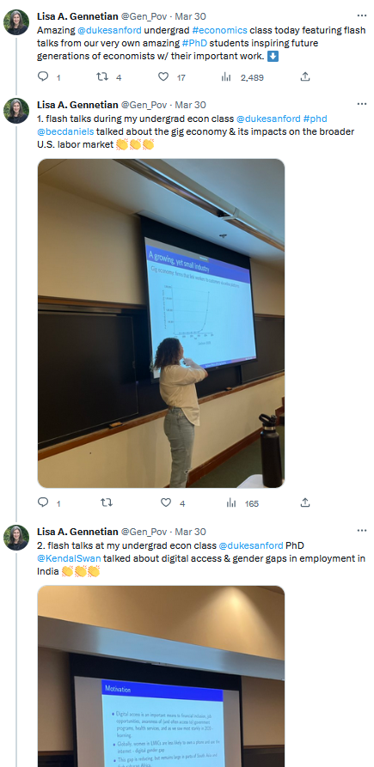
Twitter Basics
Tweets = Posts and are 280 characters or less
  Links count as 23 characters regardless of size
Retweet: Sharing another’s tweet
Quote Retweet: Sharing a tweet with a comment
Thread: Connects multiple tweets together
Hashtag (#EmScholars): Designates your tweet as part of a topical conversation
Handle or Tag (@NRCHispanic): Used to include and notify another user they are in your tweet
Notes:
Okay, let’s dive into some Twitter basics.
Most of you likely already know most of this information but we did want to define a few terms before we moved on.
First tweets are what Twitter calls posts. These can be up to 280 characters. You should also know that a link, no matter how long, counts as 23 characters.
A retweet, just means that you are sharing another’s post. You can either simply share it on your page, or you can add your own comment to it as a quote retweet.
In addition, given the short size of a tweet, you are likely to want to use a thread on occasion. This is just a way for you to connect or group multiple tweets together. For example, you may want to share the results or recommendations from a study. You could do this as a thread so that they all stay together and are shown at the same time.
Next Hashtags, or text with the pound sign in front of it, is Twitter’s method to categorize content. Hashtags can be searched by users to learn about the topics or events that matter to them, and they can be added to tweets by users to ensure they are found by people searching for those hashtags. The Center uses #EmScholars for tweets related to Emerging Scholars and #NRCHCommunidad for our webinars.
And finally, handles are simply the user or account names of those using Twitter. When you add a handle to a tweet, you are effectively tagging them. This alerts the handle owner to your tweet, which appears in their notifications alerts.

Slide 14
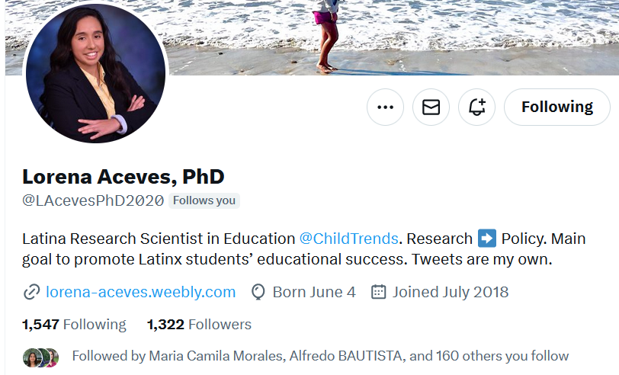
Best Practices to Build a Following: Twitter
Even if you do not include a professional affiliation in your bio, it is still advisable to include a short disclaimer (“Tweets are mine,” “tweets are my own,” “tweets do not reflect the opinions of my employer,” etc.)
Notes:
We decided not to explain how to set up a profile because most of you already are Twitter users. However, we also learned from the survey that you mainly are using it for personal use. As you begin using Twitter for professional purposes, and especially if you add an affiliation with your workplace, one of the first things you should do is provide a disclaimer that your tweets do not represent anyone but yourself. You can see that Lorena does this in her bio. Another thing that you can do, if you plan on sharing others’ posts for information’s sake alone, is to add that retweets do not equal endorsement.

Slide 15
Build Your Feed and Avoid the Muck
Build Your Twitter feed and get your first followers by
Allowing Twitter to contact your friends and ask them to follow your Twitter account
Search for people you know and follow their accounts
Search for people you want to learn more from and follow their accounts
Search for organizations that you are interested in learning from and follow their accounts
Notes:
Next, for a professional Twitter feed, you will want to curate the folks you are following. This will help you not only in finding information you want to read, but also information to share, without getting bogged down in comments that are not relevant to you. We included this section because we received a question about how to avoid the cesspool. We think this is likely a question that is on all of your minds.
To start with, it all starts with building your Twitter feed to reflect the people you want to share with and learn from. If you haven’t already, allow Twitter to search through your contacts across your various email platforms and then you can select who to follow. In turn, these folks will often follow you back.
Next search through the suggested list Twitter provides of people to follow and select those that focus on your professional work. To keep focus and enhance your brand, it can be good to avoid following profiles outside of your field of focus.
Next search for those peers and professionals that are influencers in your field and follow them. You may also want to look at the folks following them to see others that you might want to follow. They may not follow you back, yet. But following them will help you stay engaged and up to date on content, as well as set you up for future collaborative sharing strategies.

Slide 16
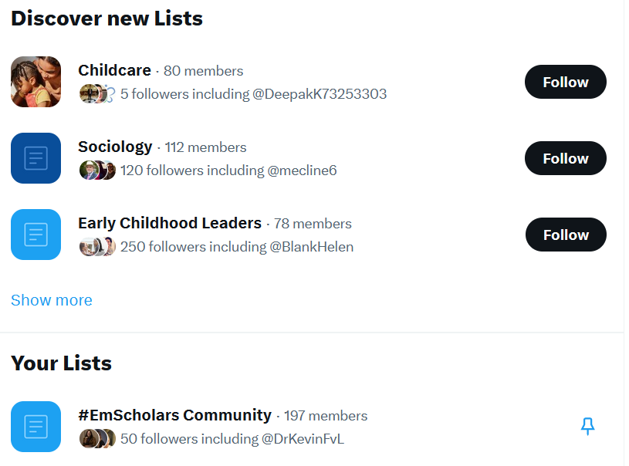
Finding People To Engage With
Twitter Lists:
  Follow and join #EmScholars Community List or other lists that you are interested in.
Influencers in the field
  Review Hashtags, find online lists, use tools (Hashtagify or RiteTag), or look for prominent people in your field.
Notes:
If you are having problems trying to find folks to follow on Twitter, there are some other ways to search. First there are Twitter lists. Twitter lists are compendiums of Twitter profiles that are selected by a list curator around a specific topic or group. For example, the Center hosts a public Twitter list that you can follow called #EmScholars Community [add to chat]. This list holds all of our past mentors and mentees accounts as well as other relevant researchers. By clicking on this list, you will find 197 members, and their daily tweets, that you can follow. Likewise, you can use the list to find tweets to share or connect your research to, but we’ll discuss that in a bit.
Another thing to look for are influencers outside of the contacts we described previously. While there are platforms that will tell you who the influencers in your field are, a cheap method to find folks beyond Twitter lists is to search for hashtags that are relevant to your work and then see who is using a hashtag. If they are above 1500 followers or you know they have a significant impact, it is probably a good idea to follow them. If you need help finding hashtags, try using Hashtagify or RiteTag. Both these sites provide lists of hashtags similar to the term you enter. RiteTag allows you to see how it is being used. Finally, Google is amazing. People have put together lists for almost everything and influencers is one of them. For example, there is a list called - 50 Sociology Professors You Can Follow on Twitter

Slide 17
Best Posting Practices: Writing a Post
Conversational, Concise, Clear
Optimal tweet length = 100 characters or less
Present new, evidence-based information more than subjective opinion (This shouldn’t always be your own content. Sharing 30% of other people’s work is a good place to start [“Research from @ABC shows XYZ.”] Read before you share.)
Use hashtags (16% engagement rate boost) and handles
Include organizations or Twitter users in your posts to attribute credit or make them aware of your post
Notes:
So now that you have the people you want to follow, presumably some of them have followed you back. Now its time to figure out how to keep them interested. A lot of you were wondering about what tweets work best. So, let’s answer that question.
How should you write your tweet? Here are some ideas…and most of these carry over to other sites as well.
First when writing a post, use a casual and personal tone of voice but remember to keep your tweets short and somewhat newsy or to the point. Twitter says stay Conversational, Concise, and Clear.
Next, keep you tweets to 100 characters or less for the best engagement, views, and clicks. Study after study has shown this.
Remember to keep the tweets focused on the work that you do. This doesn’t mean that you can’t share a picture of your kid or a happy experience now and then, but don’t blast your audience with photos of you at the bar if you are trying to cultivate an audience of researchers, policymakers, and journalists. Instead, focus on presenting new information that is relevant to your area of research, because that is why your audience is using Twitter. There are other platforms that they can use to check-up on your life.
Use hashtags (up to two) and handles. Connect your tweets to audiences through your hashtags and help get the attention of folks who may not otherwise see it. Twitter claims this increases engagement by 16%. Further, by adding the handles of those profiles affiliated with your work, you are placing it in their feeds and notification boxes. Profiles are likely to share or respond to you.
Finally, just like in a research study, Ensure that you attribute other people’s ideas and work in your posts using the author or organization’s handle

Slide 18
Best Posting Practices: Writing Post
Present data before affiliations unless the data comes from a known authority in the field
Ask a question about the research as an intro
Provide how-to’s and value adds
Use photos (38% increase) and videos (28%)
Notes:
And just a few more writing tips…
When constructing your tweets, don’t bury your lede. Put the data or compelling information first and save who did it for last.
You may also want to try starting your tweet with a leading question. For example, did you know that…. These tweets tend to raise engagement, which in turn leads to more people seeing them.
Also, in the vein of LinkedIn, consider creating Tweets or Tweet threads that describe how your users can do something. Again, these types of tweets are often shared and commented on, especially by emerging professionals.
Finally, when you can, always add photos, which Twitter says increase engagement by 38%, or short videos, which increase engagement by 28%, to a post.

Slide 19
Timing Tweets
Be sure to tweet regularly—at least once per day up to 10 times
Tweet during events and conferences
Tweet when you see something you want to respond to that fits your professional profile.
Finally, when do you tweet?
Notes:
Next, let’s talk about when to post.
It is important to tweet once a day at the very least, with three times being optimal. Many folks even tweet up to 10 times.
Considered tweeting about and during events as they are happening, especially at conferences. This is because there are a large number of people, all following the same hashtag, that are interested in the work you are doing. By including a photo or a video of what is going on, or by sharing a quote or slide from a speaker, your bringing folks who are both at the event and those who can’t attend into a shared virtual space…and also shows that you are a part of this community. You might also want to share relevant resources with to the hashtag!
Tweet when something is happening. Whether that is another account that you feel compelled to respond to or a world event. If you see a Tweet that you have the perfect answer or publication for and it fits your professional image, answer it as you see it in the comments. If a world event takes place and you have a pertinent study. post it as you learn about the event. And then find a news story on Twitter to share it in their comments. Remember, Twitter is essentially a news feed. Tweets that are late to the table rarely gain traction. But if you are adding meaningful content when that content is needed, your research will be read and your reputation will grow.
There is also a constant debate about when to tweet. We’ll start by asking you. When do you tweet. Go ahead and add your typical times in the chat.
Thanks!
While there are some traditional views and statistics on this, the reality is it is constantly shifting and is specific to your following. At the Center, we target when you wake up, when you are about to go to lunch, when you are burning out in the afternoon, and when you are sitting down after dinner Monday through Friday. But there are increasing stats showing even latter in the evening is a good time.

Slide 20
Ways to Engage and Grow
You can use Twitter to engage your audience in many ways:
Follow researchers, policymakers, administrators, reporters and influencers in your field, and those who have already followed you
Lift up other work in the field you think is interesting
Ask a question about others’ research
Connect your work to another researcher’s study or news story
Direct Message
Notes:
So, what are some ways to engage and grow your following.
Well, building a following is like building friendships. You need to create meaningful connections built on trust and reciprocity...at least till your famous.
This starts by following your followers back, whether that is an influencer or a first-year college student. This will increase the odds that they share your content.
Next lift up your followers’ work or the work of the influencers you are following by sharing it in your feed and discussing it.
Further, share their Tweets. By doing so you will create a reciprocal relationship that typically leads to mutual following and sharing. With limited time, target those inviduals who have the most influence in your field. For example, well-respected researchers or journalists.
Next, ask questions about others’ work as they post it. This will help you start a meaningful conversation that can lead to both online and offline collaboration but regardless will develop a deeper bond while also attracting others to the conversation.
Connect your work to another researcher’s study or a news story. As we mentioned in earlier, connecting your work to conversation already occurring boost your visibility, but if done in a way that is non-promotional can lead to an interesting discussion that can lead to future collaboration and work. This is likely a great time to use one of your Twitter lists to find a conversation.
Finally, Twitter offers you the opportunity to Direct Message someone. If you want to engage, what better way than to reach out.

Slide 21
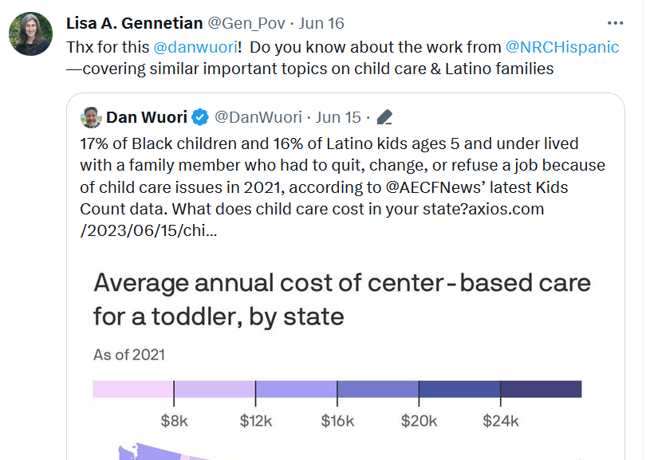
Disseminating a Study
Build the appropriate audience
Research the appropriate hashtags and include handles of people and organizations associated with the product
Join a Twitter Chat or introduce your product into a relevant conversation occurring on Twitter…such as a relevant news story, chat, or trends.
Include handles of people or organizations who you think would be interested in the information
Add a Call to Action that asks followers to share it.
Include data and results
Create a Graphic (34% more likely to be retweeted, 94% more views) or a Video presentation
Notes:
So, my monologue is about to end but after hearing from you all that you are interested in learning more about disseminating research, the last thing we want to discuss today are ways to ways to better promote your reports and publications.
Here are the basics, and they are going to sound familiar, so much so that it may even be a bit of a recap.
First, make sure that you have the appropriate following to present your documents to.
Next use hashtags and include the handles of the people and organizations associated with or who might be interested in your research. You can use sites like Hashify or RiteTag to research hashtags to find these.
Next, find relevant conversations happening on Twitter and include a thoughtful tweet that introduces your work. This can be a response to a recent news article posted by a reporter, a twitter chat hosted by a policy group, or simply a tweet that has garnered a lot of response. You may also consider looking for relevant trending topics and hashtags join that conversation.
When drafting a tweet, add a call to action. If you want people to read the document, ask them to read it. If you want them to share it, ask them to.
And finally, include data, results and graphics in the post. People like to retweet numbers. They hold an edge of authority and provide quick,diffinitive information that Twitter users thrive on. Likewise, where you can, include charts or visual representations of the data at its findings. This can lead to an increase of 34% more retweets than for a similar post without a photo.

Slide 22
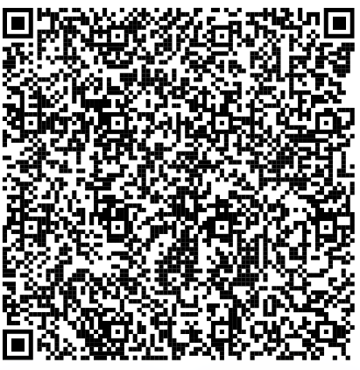
Starting Your Professional Account
Let’s stay connected
Enter Your Twitter Handle in the chat.
Click on the hashtag
And add the handles!
Now click send.
Notes:
So, to help get your professional Twitter account started with some followers who are going to help you share your work, we’d like you all to enter your Twitter handle in the chat.
Now, take out your phone and use the QR Code.
You’ll see that you have been taken to a Tweet in Twitter. Now, please delete the x’s and replace them with the handles in the chat. We’ll wait a second.
Okay, click send. It’s fine if you didn’t get all the handles in there. We’ll send you the rest of the handles tonight. But when you go home later today, we’d love it if you would follow everyone on that tweet and list. Then the big ask. Please stay in contact and help each other share content or simply discuss your work.

Slide 23
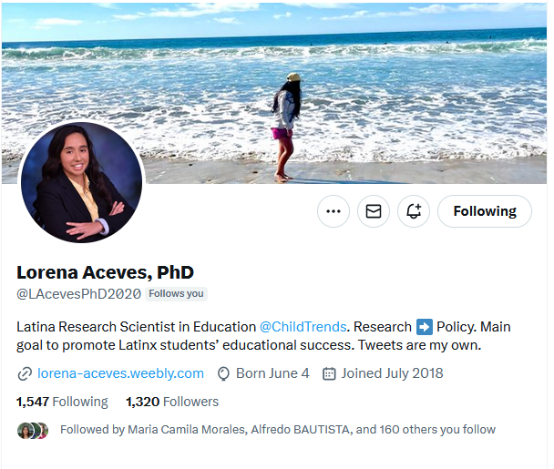
Practical Illustration: With Lorena Aceves
Notes:
We hope these tips have been helpful in giving you an idea about how to use social media in your professional career.
Lorena Aceves is a researcher at Child Trends who has built a following of over 1,300 followers. Through her feed she promotes her professional growth as well as her podcast Vida De PhD.
We’ll turn it over to Lorena to discuss some of how she worked grow her Twitter following and its importance to her professional career.
But if you have questions, we’ll be taking those in the last ten minutes or so.

Slide 24
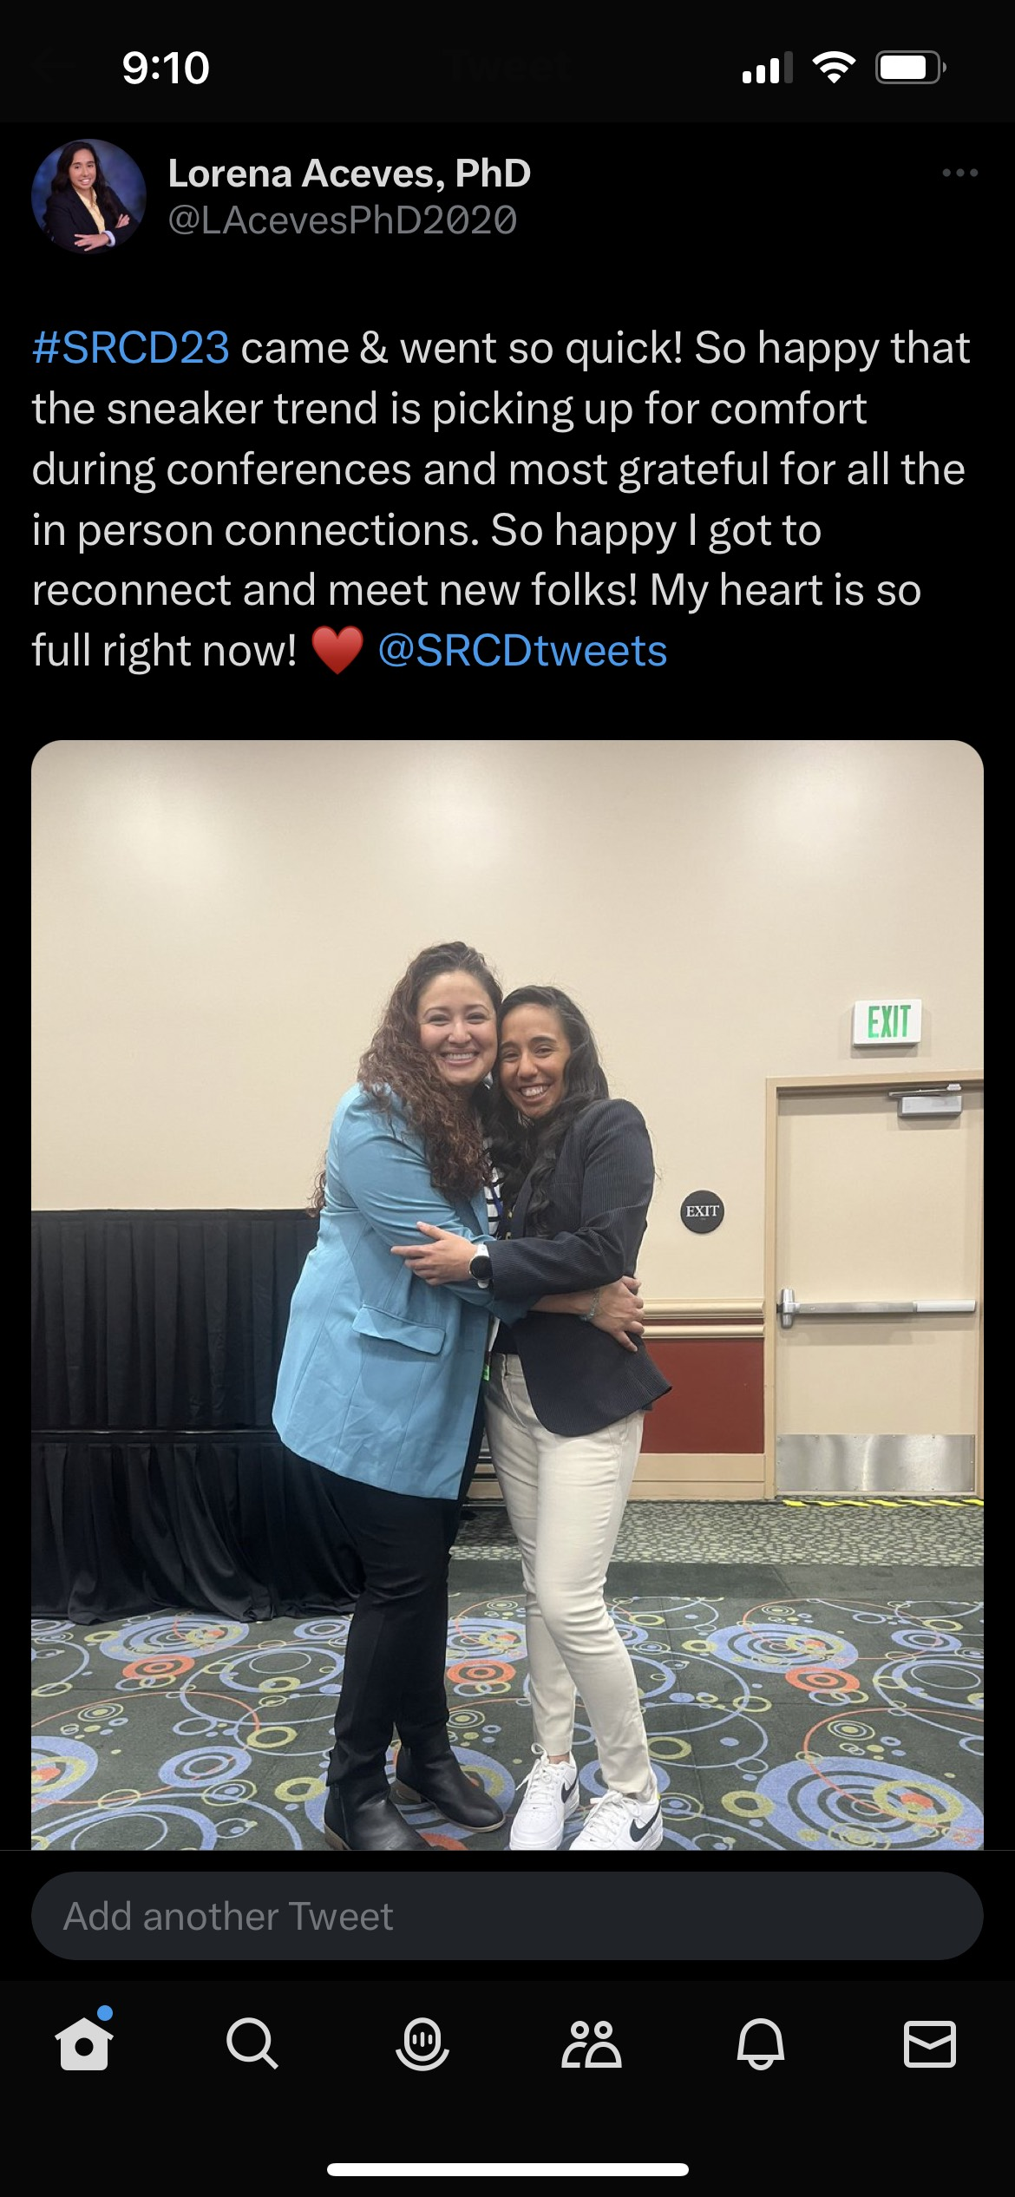
Practical Illustration: With Lorena Aceves

Slide 25
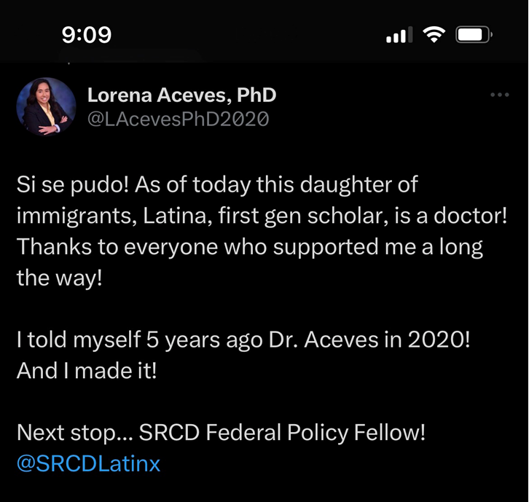
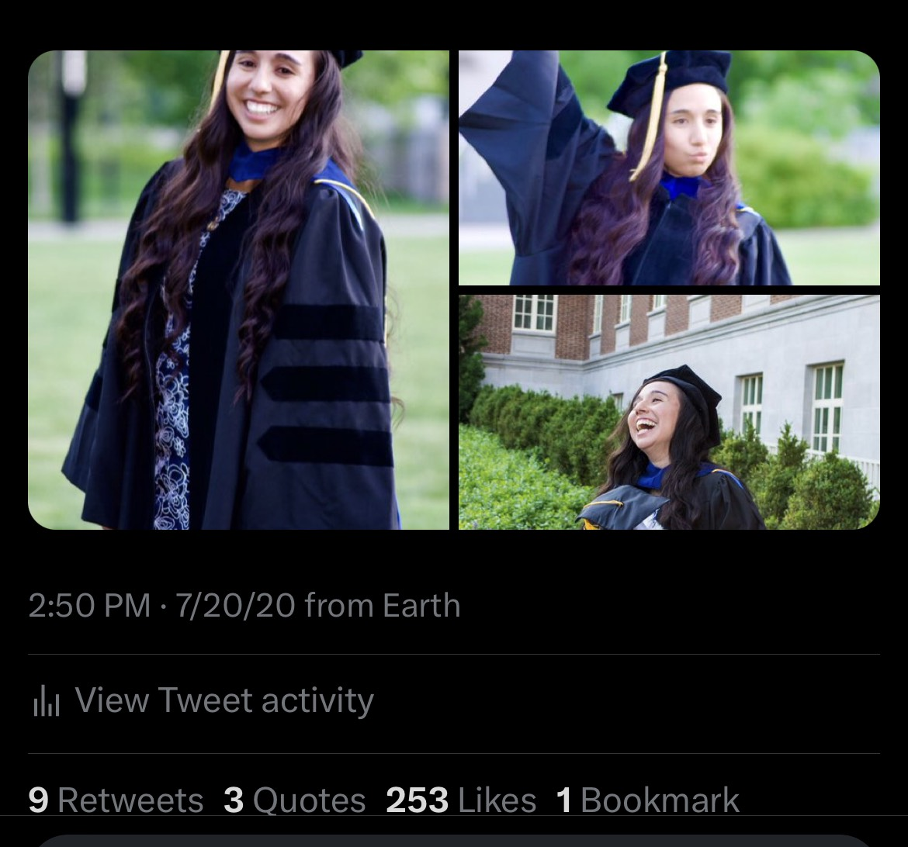
Practical Illustration: With Lorena Aceves
Notes:
Lorena Aceves, PhD on Twitter: "Phew! It’s been 4 months now since I wrapped up my time @HeadStartgov ! Here’s a in depth look into my second year of the @SRCDtweets fellowship there. Miss my Head Start family so much." / Twitter

Slide 26

Questions

Slide 27
Tools
Hashtag Tools
Hashtagify https://hashtagify.me/hashtag/research
RiteTag https://ritetag.com/
TagsFinder https://www.tagsfinder.com
Schedulers:
Tweet Deck (Free. Only for Twitter)
Buffer (3 channels – LinkedIn, Facebook, Twitter, etc. Schedule 10 post per channel)
Each channel also has its own built in scheduler
Analysis Tools (Best times to post and influential followers):
Social Bearing (Blocked by Twitter)
FollowerWonk (Blocked by Twitter)

Slide 28
Facebook Tips
Friends: Request friendship with the people you know, acquaintances from conferences, close colleagues
Writing Posts: Post should typically be about 80 characters long while including topic relevant hashtags and tagging individuals who may find your content useful
Writing Posts: Post content that is meaningful to you and explain the post so that it is clear why it should be meaningful to others.
Share: Blog Posts, pictures (30% more views), short videos (30 seconds to a minute in length and 5 minutes or longer with a hook in the first 5 seconds)
Tools: Create Events, Create Reels, Create Facebook Live events, join Facebook Groups
Privacy Settings: Make your posts public
Notes:
Here are just a few tips on using Facebook.
Tip one, build the correct audience for your outreach. You likely have your family and friends, but if you want to use Facebook as a tool to present your work, begin making Facebook Friends with folks that you are meeting in conferences, workshops, or anywhere that you decide a real connection has been made. Don’t SPAM everyone you barely met in a meeting, but if there someone you genuinely felt like had a conversation with, consider adding them.
Tip Two: When writing posts try to stick to around 80 characters. These have a 66 percent higher engagement than posts longer than that. Why? Likely because Facebook forces you to click to expand any content that is longer.
Tip Three: Write content in a way that it expresses its meaningfulness to you and to others. Tell people why results are important, not just what the result were.
Tip Four: Always attach photos to posts that you want to be engaged with. They garner 30% more views. Video also does well, but keep them short. 30 seconds to one-minute videos get the most views.
Tip 5: Facebook has a lot of tools you can use to share your content or make connections. Consider creating a Facebook event tied to the release of your product. Create short videos explaining report recommendations or important findings to add to Reels or your Story feed, and finally Facebook is full of groups for almost every topic under the sun. Join one of these groups and share your work and research with its members
Tip 6: Finally, Most of your Facebook posts are hopefully set to private, make sure that for the posts you would like to see get public attention that you have set the privacy settings to public and shareable.

Slide 29
LinkedIn Tips
Tip 1: Let your profile tell your story
Tip 2: Strategically connect to colleagues and follow thought leaders you respect
Tip 3: Strategically add jobs and skills that illustrate your preferred career and research path
Tip 4: Join research-oriented groups
Tip 5: Share your work in short posts and publish long form how-to’s or similar value ads that share your expertise
Tip 6: Turn on Creator mode if you plan to post often
Notes:
You’re LinkedIn profile represents not just how people view you as a professional but how you want them to perceive you. Therefor tailor it for the professional goals that you have.
Tip one: Your profile description should not be your current title. Instead use this field to describe what you do and are. Then follow this up in your bio to make clear what you bring to the profession and your area of work. For example, I use Strategic Communications Leader and follow it up with a short bio - I direct, manage and aid individuals and organizations in building community, brand, dialogue, and change through strategic communications.
Tip two: Unless the request is from someone you truly respect, accept requests only from people you know or want to know in a professional setting on linkedin. Likewise, try to tailor these specifically to the areas in which you want to grow. This will help reduce the chatter on linkedin, reduce bots, and decrease unwanted recommendations. At the same time, do connect with fellow colleagues and solicit recommendations from colleagues -- and follow thought leaders in your field.
Tip3. Don’t list every job and skill you have ever had, it is not a job application or FBI background check. Instead, strategically choose the skills and jobs that you want to be known for. In this way you begin to create your professional brand image. Your peers don’t need to know that you worked at the mom-and-pop fast food chain down the road during college…unless you want to make that a part of your brand. Now if you were a politician, I’d advise you did this. As a researcher, it doesn’t make a lot of sense.
Tip4: Like Facebook, join groups and share your work in these groups, asking thoughtful questions about what you have accomplished while also asking for feedback. Don’t just spam the group with your work.
Tip5: Also like Facebook share short posts that are roughly 100 charters long in your feed. These can be blog posts that you may have as well as research studies or recent publications, work events, job opening, and other people’s posts. Unlike Facebook use the Linkedin publishing feature for long-form articles. These long-form pieces, especially how-tos help to enhance your brand as a thought leader in the field. Further, LinkedIn prioritizes posts without external links in their algorithm leading to more people seeing your work.
Tip6: Turn on Creator Mode. Creator Mode gives you the ability to showcase your work in a block format, and also provides you with tools such as LinkedIn Live (broadcast live to your page), Audio Events, essentially live podcast the audience can participate in, Newsletter (essentially a listserv informing subscribed users that you published an article), and the addition of a follow link…which sets people as followers whenever they looking to connect with you. In addition, it increases your visibility to users in the algorithm.
Finally, as noted in posts, LinkedIn is a social networking platform. This means it is important to engage with and share other people’s work. Do this and they are likely to follow you back and from there you can start up a long-lasting conversation or collaboration.

Slide 30
Disclaimer
The views expressed in this presentation do not necessarily reflect the views or policies of the Office of Planning, Research, and Evaluation, the Administration for Children and Families, or the U.S. Department of Health and Human Services.

