Slide 1




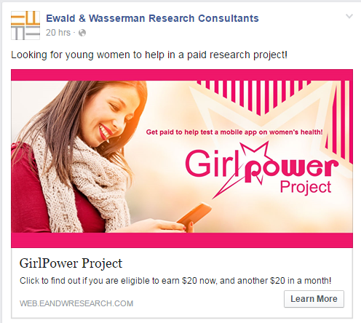

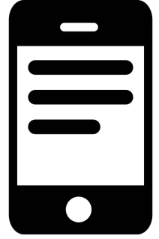

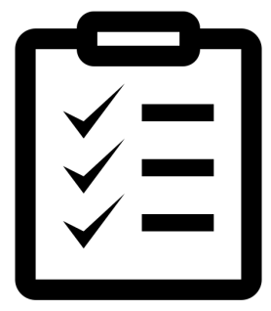










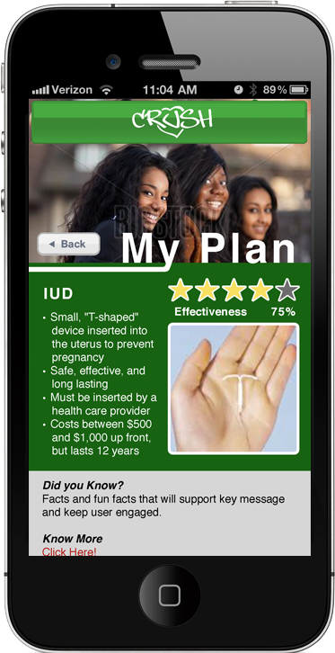
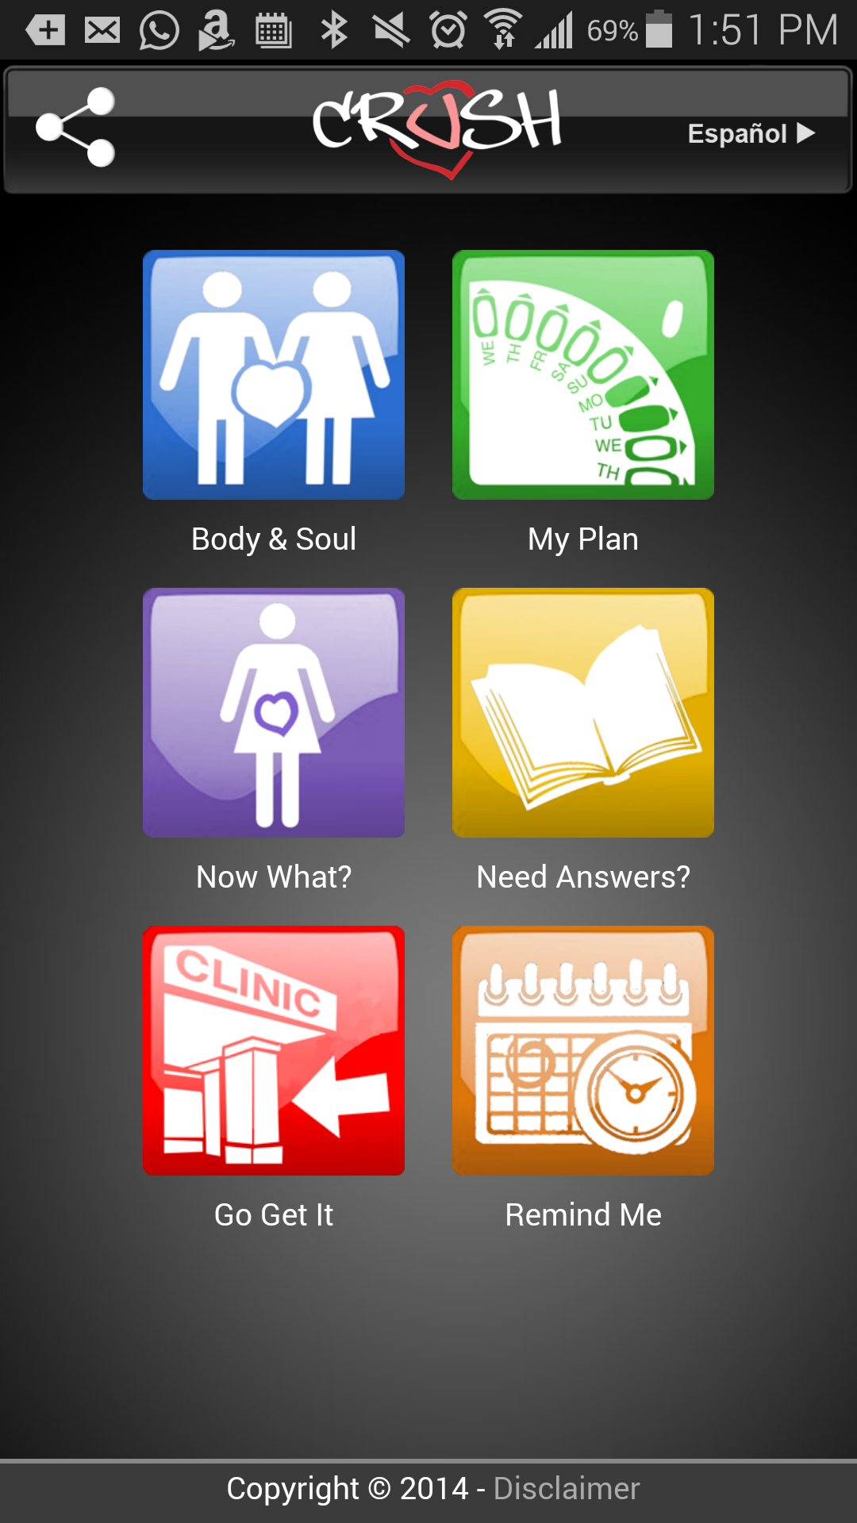
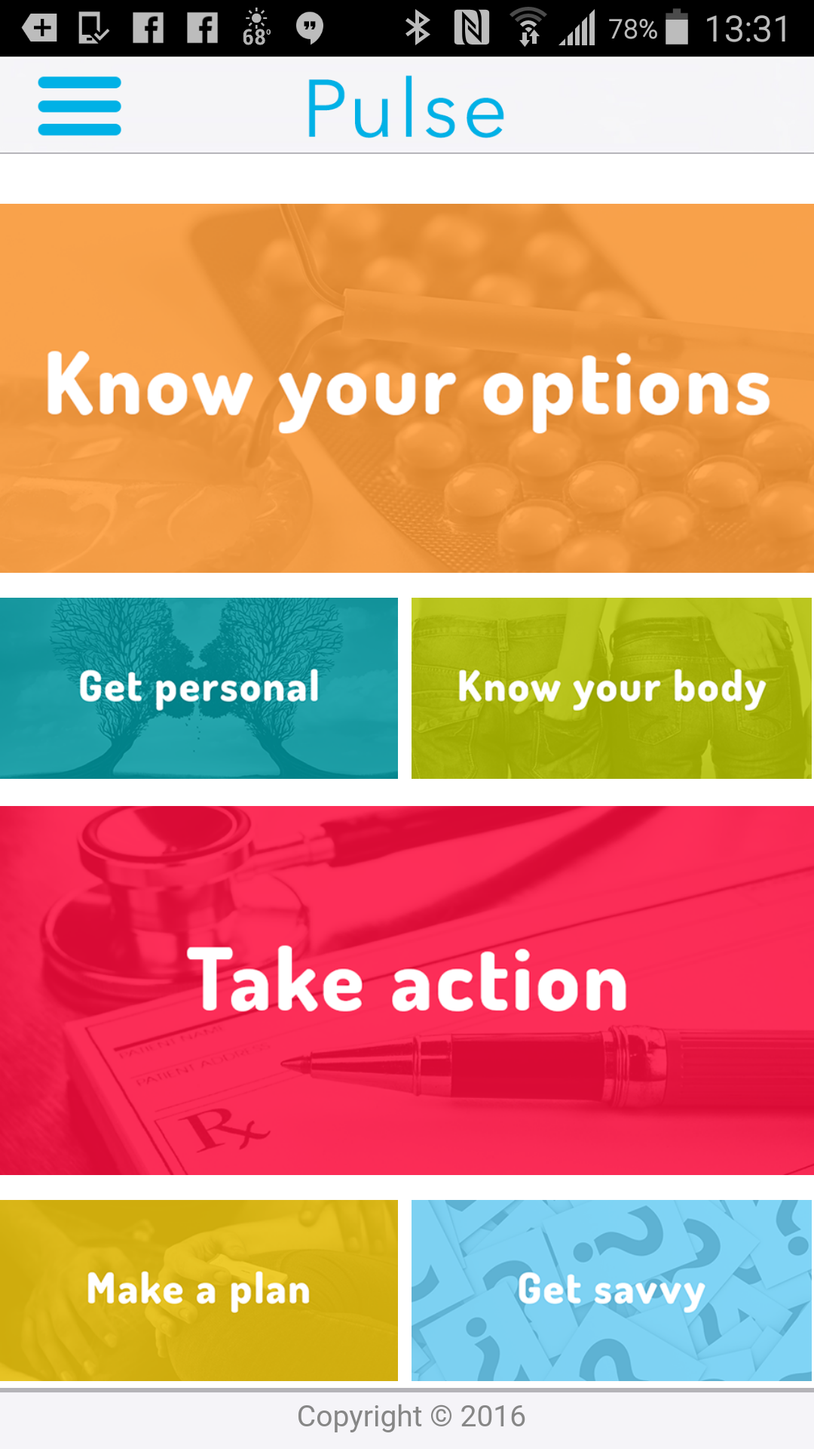
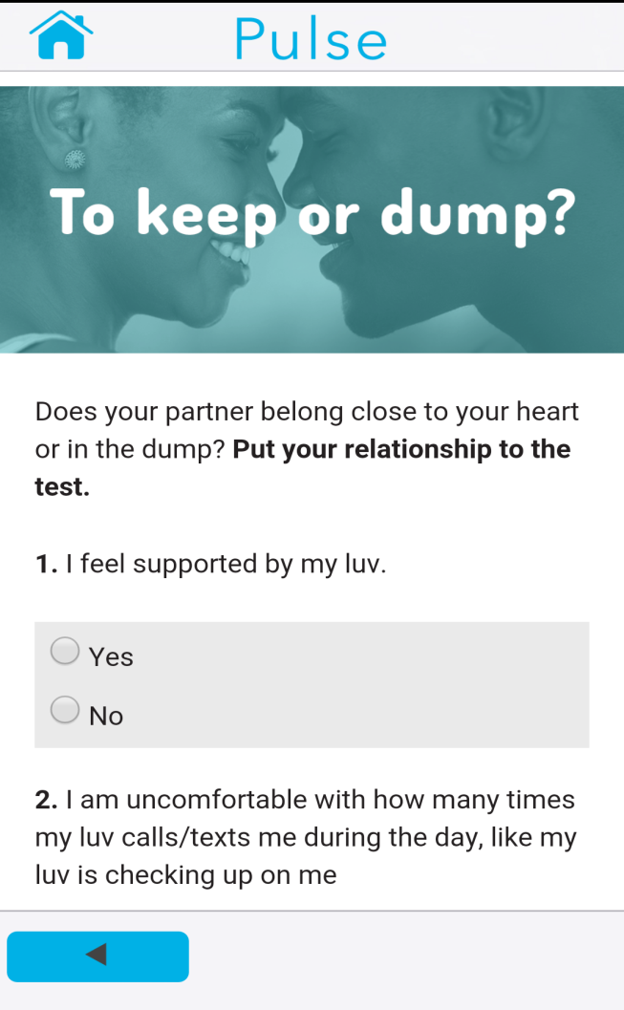
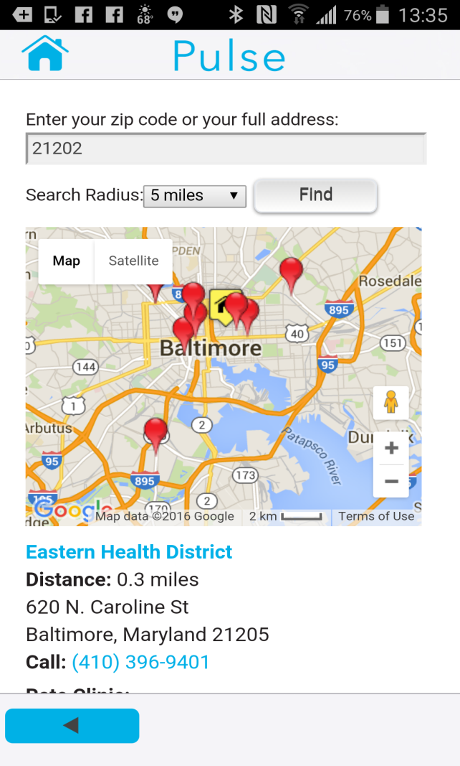
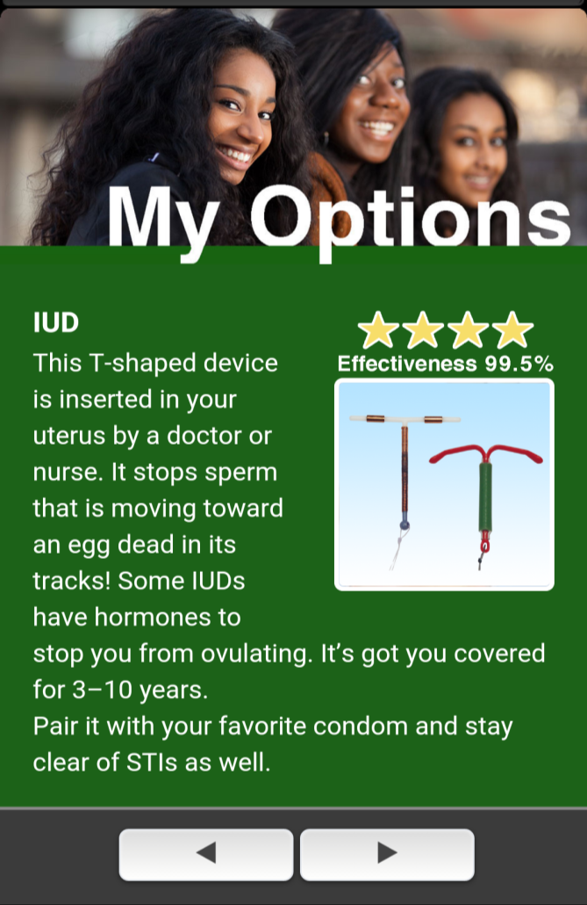
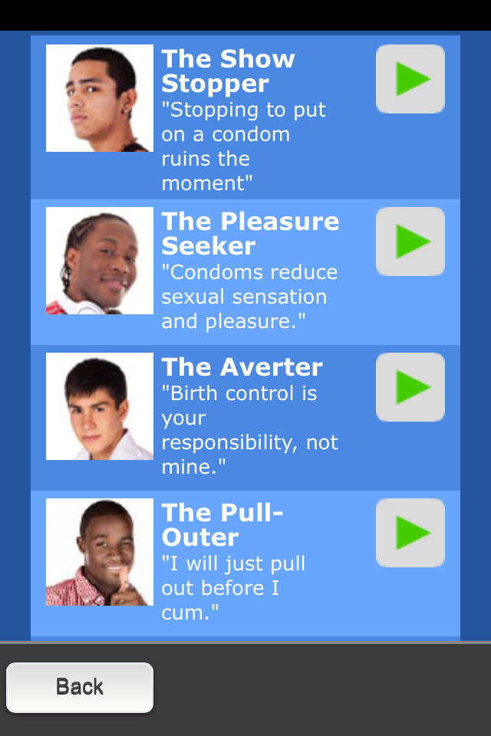
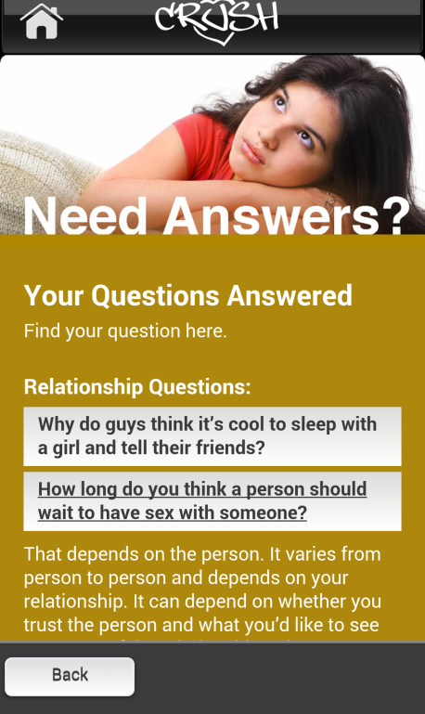
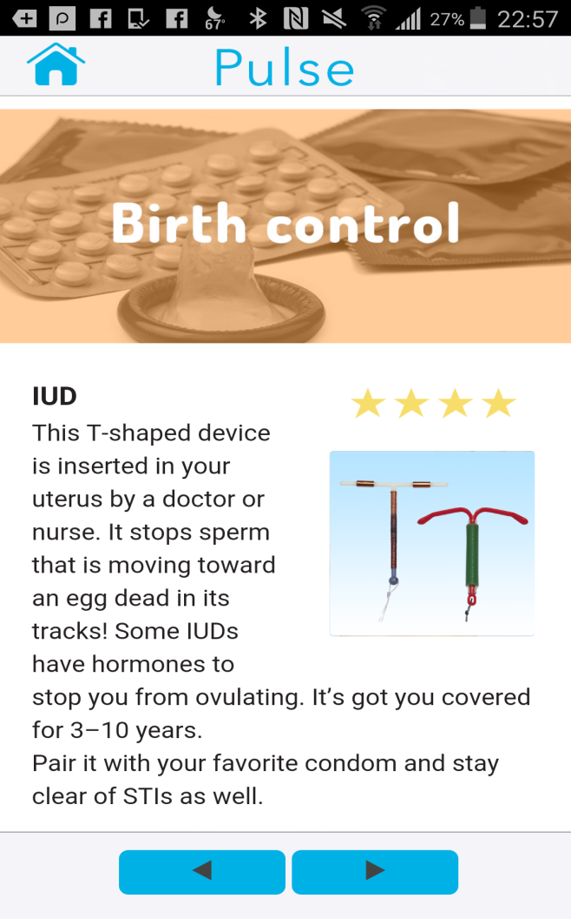
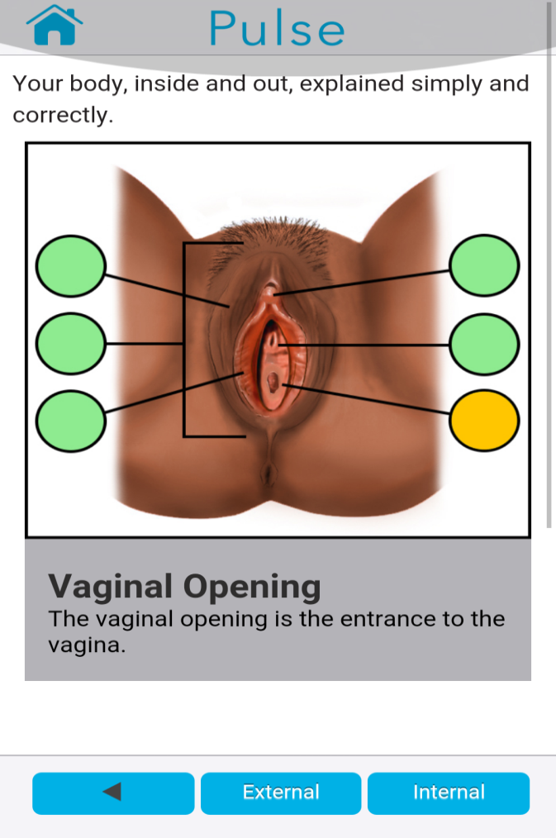
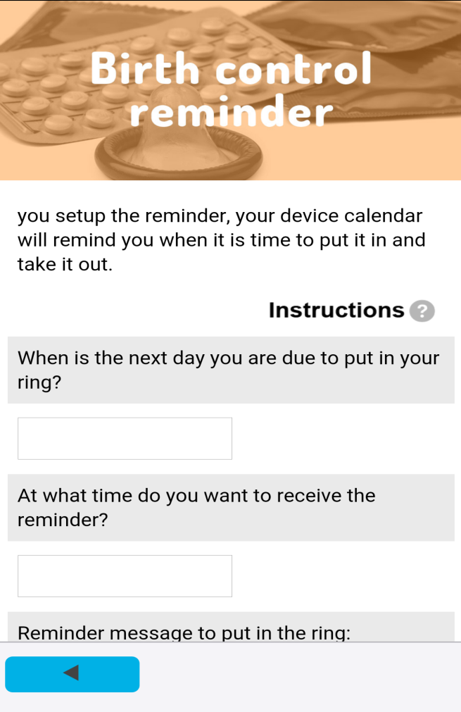
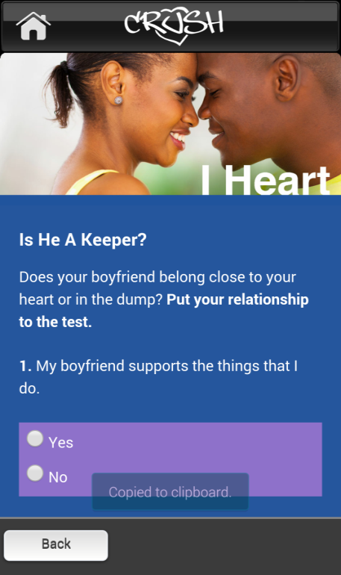
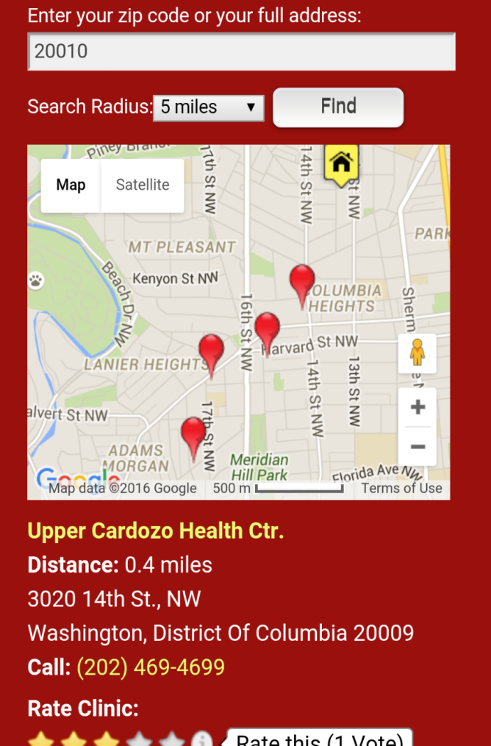
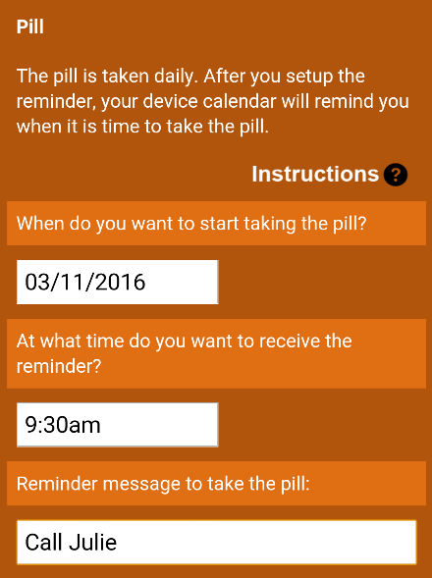
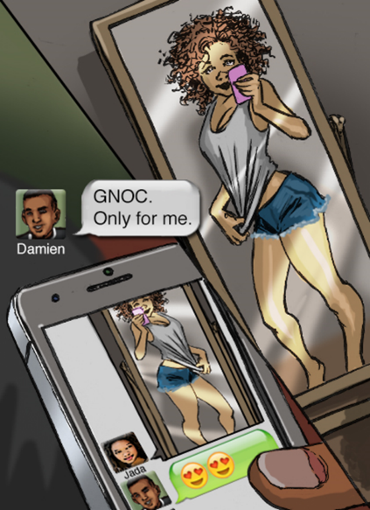
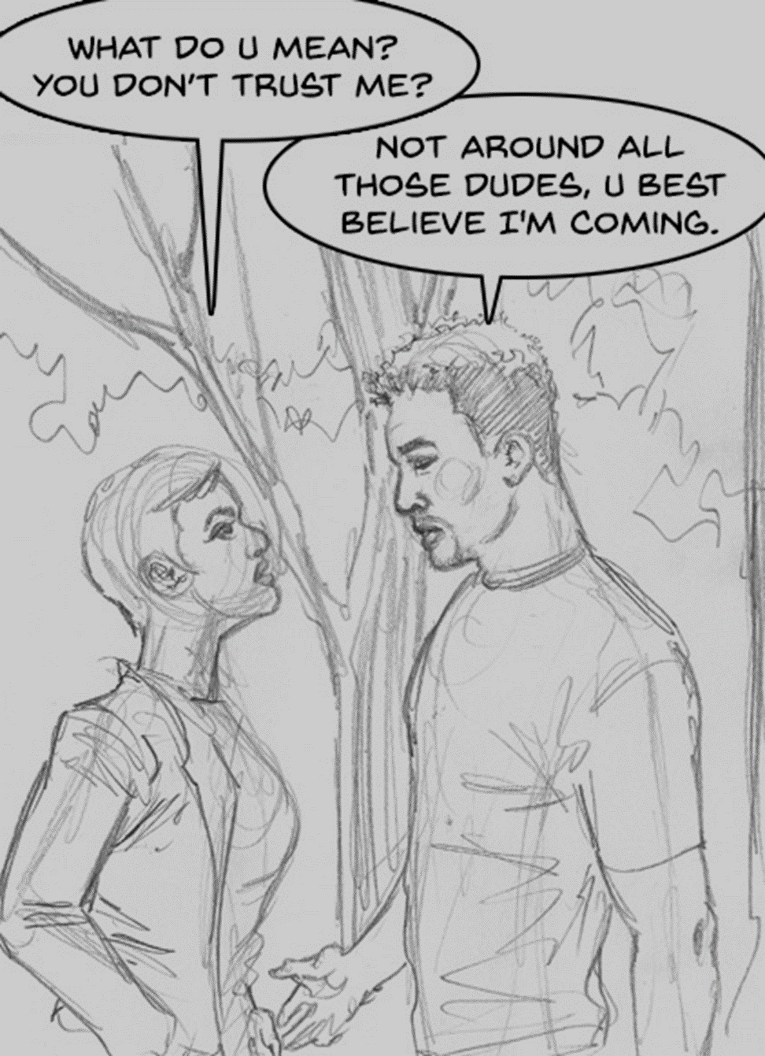
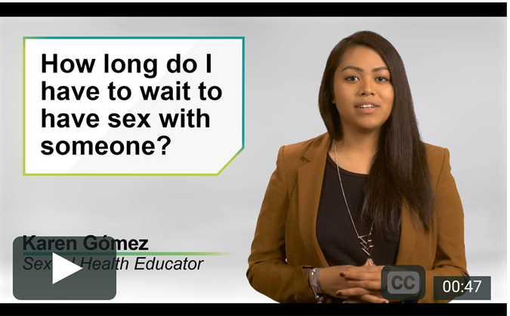
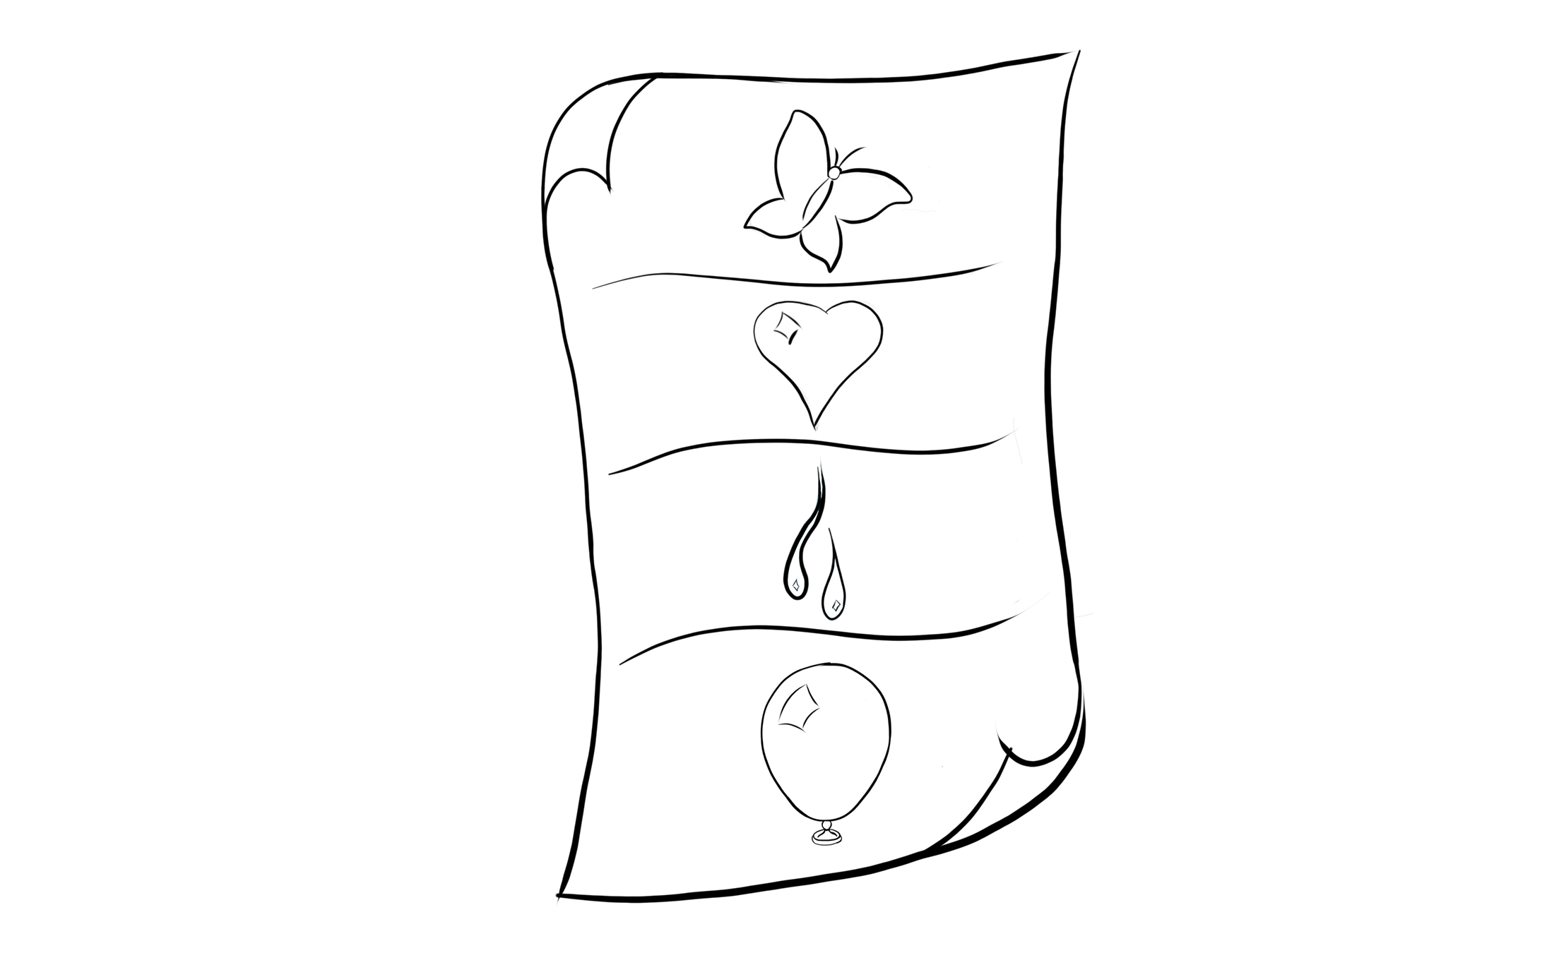
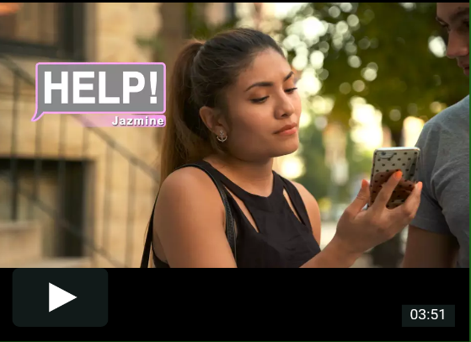
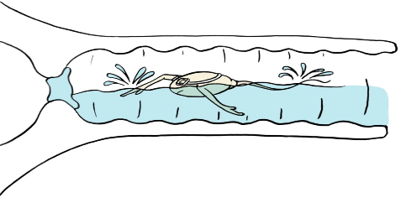
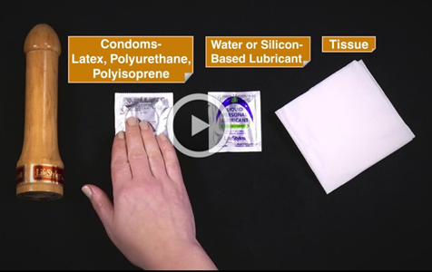
Teen Pregnancy Research 2.0:
Taking sexual health research to the mobile world
¹Genevieve Martínez García, Mila Garrido, Yewande Olugbade, Alex Eisler, Pat Paluzzi, Kelly Connelly
²Jennifer Manlove, Elizabeth Cook
1 Healthy Teen Network, 2 Child Trends
Goals & Objectives
Research Design & Timeline
Conclusions
Background: Youth’s connectivity to the mobile world and the rapid development of mobile technology make the field of mHealth a perfect platform to widely disseminate confidential, medically accurate, and comprehensive information on reproductive and sexual health.
Aims: To adapt an existing app (Crush) and test its efficacy among older teen.
Behavioral objectives: Increase use of effective contraception and increase clinic utilization.
Pulse’s Attributes:
Recruitment rolling basis
3 Month Follow-up
12 Month Follow-up
Design:
What we learned from the YAB
Colorful yet elegant and simple.
Liked easy navigation.
Add more content on pleasure and LGTBQ.
Older youth could relate to original Crush app.
Some wanted sex explicit name, other preferred neutral name for the app.
Research:
What we learned from the pilot and in-depth interviews
Recruitment strategy:
Branding materials strengthens trust in study.
Social media, particularly Instagram and Twitter, is effective strategy for recruiting young women.
Financial incentive is strong motivator for participation.
Texts play key role in engaging participants over time.
Enrollment deterrents:
Perceived untrustworthy due to: glitches in system and lack of branding cohesiveness.
Concern with data security, data usage & legitimacy of study.
Other challenges:
Linking data collection and app usage systems.
Coordinating informational, app usage reminder, and follow-up survey texts so not to overwhelm participants.
Control
Online
recruitment
Screener, Consent, Enrollment & Baseline
Weekly Texts
Randomization
Survey & Web Analytics
Survey & Web Analytics
Teen Pregnancy
Latino & Black Women
18-19 years old Black
Recruitment via Facebook, Twitter, Craigslist and Community Colleges
Randomization stratified by age and race/ethnicity.
Must complete minimum amount of browsing to get incentive.
Tools
Medically Accurate
Online surveys and app usage analysis per participant.
Pilot followed up for 1 month only.
LGTBQ friendly
Theory-Based
Control website designed for study with general wellness info.
Evidence Based
Rigorously Tested
ñ
English/ Spanish
Rebranding & Adaptation
Adaptation Team:
Youth Advisory Board (15 young diverse women)
Internal Medical Accuracy Board (4 clinicians)
Age Appropriateness (2 researchers/ developers)
LGTBQ Inclusiveness (2LGTBQ advocates/educators)
Main Changes:
Update visual design.
Add new media with relevant themes.
Enhance medical information.
Add gender neutral language.
Crush was funded by the Division of Reproductive Health
Centers for Disease Control and Prevention
SBIR contract CDC: 200-2014-60872
Comics
Videos
Animations
Comics
Video FAQs
Video Demos
Animations
Pulse is being funded by the Office of Adolescent Health US Department of Health and Human Services
Grant: TP2AH000038-01-01

